Slide 1

MB-910
DYNAMICS 365 CRM
MASTER TRAINER SLIDES · WSQ
Microsoft Dynamics 365 Fundamentals (CRM) (MB-910)
WSQ Course Code: TGS-2023040481 · 2-Day Hands-On Training · 16 Hours
Skills Framework TSC: Customer Relationship Management (RET-RAN-4001-1.1)
Conducted by Tertiary Infotech Academy Pte Ltd · UEN 201200696W
Version v6 · 1 September 2026 · Trainer: Dr. Alfred Ang
© 2026 Tertiary Infotech Academy Pte Ltd. All rights reserved. · www.tertiarycourses.com.sg

Slide 2
COURSE ADMINISTRATION
Welcome & Housekeeping
Microsoft Dynamics 365 Fundamentals (CRM) (MB-910) · TGS-2023040481
© 2026 Tertiary Infotech Academy Pte Ltd
2

Slide 3
MANDATORY · SSG / WSQ
Digital Attendance & TRAQOM Survey
Three attendance takes
AM, PM and Assessment — every day of a WSQ-funded course.
1
The trainer shows the QR
Generated live from the SSG portal — it changes each session.
2
Scan and submit
Open your phone camera, scan, and submit your attendance.
3
75% minimum
Below 75% attendance you lose funding eligibility and cannot be assessed.
4
Scan with your phone camera
TRAQOM survey
Complete the mandatory course survey on the LMS before you leave.
5
Microsoft Dynamics 365 Fundamentals (CRM) (MB-910) · TGS-2023040481
© 2026 Tertiary Infotech Academy Pte Ltd
3

Slide 4
YOUR TRAINER · GENERAL
About the Trainer
NAME
____________________________________________
?
TITLE / DESIGNATION
____________________________________________
QUALIFICATIONS
____________________________________________
Your Trainer
AREAS OF EXPERTISE
____________________________________________
General Trainer template —
to be completed by the trainer
TRAINING & INDUSTRY EXPERIENCE
____________________________________________
CONTACT
____________________________________________
Microsoft Dynamics 365 Fundamentals (CRM) (MB-910) · TGS-2023040481
© 2026 Tertiary Infotech Academy Pte Ltd
4

Slide 5
YOUR TRAINER
About the Trainer
ROLE
Principal Trainer, Tertiary Infotech Academy Pte Ltd
AA
BACKGROUND
PhD — 20+ years of industry and training experience in enterprise software, cloud platforms and business applications.
DELIVERS
WSQ courses on Microsoft Dynamics 365, Power Platform, data analytics, AI and cloud technologies.
Dr. Alfred Ang
CERTIFICATIONS
Microsoft Certified Trainer; Dynamics 365 and Power Platform certified.
Principal Trainer
Tertiary Infotech Academy Pte Ltd
FOUNDER
Founder and lead instructor at Tertiary Infotech / Tertiary Courses.
Microsoft Dynamics 365 Fundamentals (CRM) (MB-910) · TGS-2023040481
© 2026 Tertiary Infotech Academy Pte Ltd
5

Slide 6
ICE-BREAKER
Let's Know Each Other
Who you are
Your name, your organisation and your role.
Your CRM experience
Dynamics 365, Salesforce, HubSpot — or none at all. All are welcome.
1
2
Which part you own
Marketing, sales, customer service or field operations?
Your goal for tomorrow
One thing you want to be able to do with Dynamics 365 by the end of Day 2.
3
4
Microsoft Dynamics 365 Fundamentals (CRM) (MB-910) · TGS-2023040481
© 2026 Tertiary Infotech Academy Pte Ltd
6

Slide 7
HOUSEKEEPING
Ground Rules
1
Set your mobile phone to silent mode.
2
Participate actively — no question is too small.
3
Respect each other's views; agree to disagree.
4
One conversation at a time.
5
Step out quietly for calls or breaks.
6
Be punctual; return from breaks on time.
7
75% attendance is required for funding.
8
Ask for help the moment a lab step fails.
Microsoft Dynamics 365 Fundamentals (CRM) (MB-910) · TGS-2023040481
© 2026 Tertiary Infotech Academy Pte Ltd
7

Slide 8

COURSE PORTAL
Login to LMS and Download Course Material
Log in at lms-tms.tertiaryinfotech.com with your registered email and the OTP sent to your inbox, then open this course to download the slides and Learner Guide.
All course material is downloaded from the LMS/TMS portal — keep it open: the final assessment is open book.
Microsoft Dynamics 365 Fundamentals (CRM) (MB-910) · TGS-2023040481
© 2026 Tertiary Infotech Academy Pte Ltd
8

Slide 9
COURSE PORTAL · LMS/TMS
Download Course Material
https://lms-tms.tertiaryinfotech.com
Sign in
lms-tms.tertiaryinfotech.com — log in with your registered email.
1
Tertiary Infotech LMS/TMS
My Courses · Attendance · Assessment
Open your course
Select this course under My Courses.
2
Microsoft Dynamics 365 Fundamentals (CRM) (MB-910)
Trainer Slides (PDF) ⬇
Download materials
Slides, Learner Guide and lab files — your open-book references.
Learner Guide (PDF) ⬇
3
Lab Files & Mock Data ⬇
Submit & survey
Upload your assessment answers and complete the TRAQOM survey.
Assessment Submission ↗
4
All course material is downloaded from the LMS/TMS portal — keep it open: the final assessment is open book.
Microsoft Dynamics 365 Fundamentals (CRM) (MB-910) · TGS-2023040481
© 2026 Tertiary Infotech Academy Pte Ltd
9

Slide 10
HANDS-ON · 10 LABS
Your Lab Environment
https://make.powerapps.com
Sign in
Use the trainer-provided training<N>@tertiaryinfotech.onmicrosoft.com account.
1
Power Platform · Dynamics 365
Environment: Contoso Coffee Singapore (trainer tenant)
Prefix your records
Add your initials to every record — the tenant is shared with the class.
2
Sales Hub
Customer Service Hub
Import the mock data
Each lab folder carries its own CSV files to import.
Field Service
3
Customer Insights – Journeys
Follow the Learner Guide
Every step, field value and verification is written there.
Customer Voice
4
No Dynamics 365 tenant? A 30-day trial at trials.dynamics.com gives you every app used in these labs.
Microsoft Dynamics 365 Fundamentals (CRM) (MB-910) · TGS-2023040481
© 2026 Tertiary Infotech Academy Pte Ltd
10

Slide 11
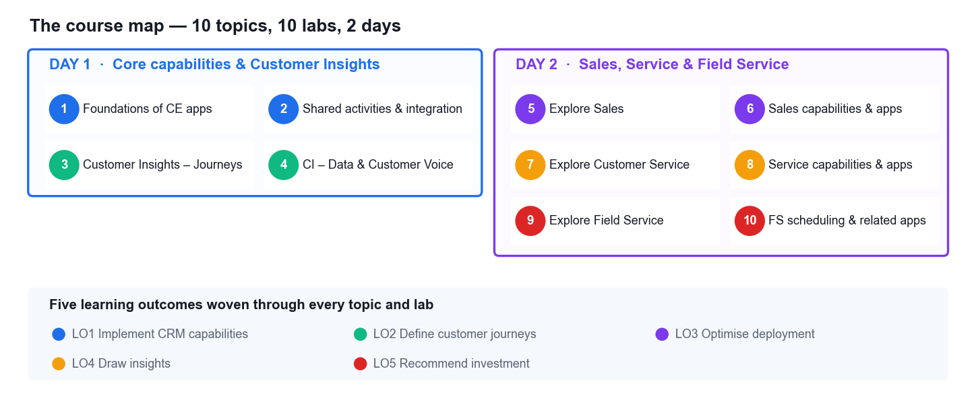
WHERE WE ARE GOING
The Course Map
Day 1 builds the platform foundations and the marketing apps; Day 2 covers Sales, Customer Service and Field Service, ending with the assessment.
Microsoft Dynamics 365 Fundamentals (CRM) (MB-910) · TGS-2023040481
© 2026 Tertiary Infotech Academy Pte Ltd
11

Slide 12
SCHEDULE · 8 TRAINING HOURS
Lesson Plan — Day 1
Core platform & shared capabilities
The Customer Insights apps
• Morning · AM digital attendance
– Welcome, introductions, ground rules, learning outcomes
– Topic 1 — Foundations of Dynamics 365 CE apps
– Lab 1 — Navigate Dynamics 365 and explore Dataverse
– Tea break (15 min)
– Topic 2 — Shared activities and integration options
– Lab 2 — Manage customers, activities and reporting views
– Lunch break 1:30–2:30pm
• Afternoon · PM digital attendance
– Topic 3 — Customer Insights – Journeys
– Lab 3 — Build a segment, an email and a customer journey
– Tea break (15 min)
– Topic 4 — Customer Insights – Data and Customer Voice
– Lab 4 — Unify customer data and capture feedback
– Day 1 recap and Q&A
9:30am–6:30pm · 1-hour lunch · tea breaks counted within training time.
Microsoft Dynamics 365 Fundamentals (CRM) (MB-910) · TGS-2023040481
© 2026 Tertiary Infotech Academy Pte Ltd
12

Slide 13
SCHEDULE · 8 TRAINING HOURS
Lesson Plan — Day 2
Sales & the start of Service
Service, Field Service & assessment
• Morning · AM digital attendance
– Day 1 recap
– Topic 5 — Explore Dynamics 365 Sales
– Lab 5 — Run the lead-to-cash cycle
– Tea break (15 min)
– Topic 6 — Sales capabilities and related apps
– Lab 6 — Forecast the pipeline and evaluate Sales Insights
– Topic 7 — Explore Dynamics 365 Customer Service
– Lunch break 1:30–2:30pm
• Afternoon · PM & assessment attendance
– Lab 7 — Resolve a case with knowledge, queues and SLAs
– Topic 8 — Service capabilities and related apps
– Lab 8 — Omnichannel, supervisor insights and analytics
– Topic 9 & 10 — Field Service and scheduling
– Labs 9 & 10 — Work orders, scheduling, assets and IoT
– Briefing for assessment
– Written Assessment (1 h) + Practical Performance (1 h)
The final assessment runs from 4:30pm on Day 2 — 2 hours in total, open book.
Microsoft Dynamics 365 Fundamentals (CRM) (MB-910) · TGS-2023040481
© 2026 Tertiary Infotech Academy Pte Ltd
13

Slide 14
WSQ ALIGNMENT
Skills Framework — Customer Relationship Management
TSC element
Detail
TSC Title / Code
Customer Relationship Management · RET-RAN-4001-1.1
Ability A1
Develop and manage plans for implementing new CRM capabilities
Ability A2
Review research findings and recommend investments in CRM tools and technologies deployment
Ability A3
Manage and monitor optimisation of CRM tools and technologies
Ability A4
Draw and communicate insights from CRM data
Ability A5
Draw insights into team's performance and fine-tune sales processes
Ability A6
Utilise appropriate tools to share information and stay connected from anywhere
Ability A7
Develop and define customer journeys for marketing and remarketing
Knowledge K1
Organisation's CRM strategies
Knowledge K2
Limitations of CRM
Knowledge K3
Opportunities of CRM
Knowledge K4
Types of CRM technology and tools
Knowledge K5
Criteria for recommending investments in CRM tools and technologies
Knowledge K6
Criteria for improving existing CRM practices and programmes
Knowledge K7
Processes involved in monitoring optimisation of CRM tools and technologies
Knowledge K8
Methods for drawing and communicating insights from CRM data
Knowledge K9
Criteria for reviewing research findings related to CRM
Every topic, lab and assessment item in this course maps to these TSC abilities and knowledge factors.
Microsoft Dynamics 365 Fundamentals (CRM) (MB-910) · TGS-2023040481
© 2026 Tertiary Infotech Academy Pte Ltd
14

Slide 15
BY THE END OF THIS COURSE
Learning Outcomes
1
LO1
Develop strategies for implementing Microsoft Dynamics 365 CRM capabilities and utilising the tools to disseminate information
2
LO2
Develop frameworks to define customer journeys for marketing on Microsoft Dynamics 365 CRM
3
LO3
Manage strategies to optimise the deployment and performance of Dynamics 365 customer engagement apps
4
LO4
Draw actionable insights from Dynamics 365 CRM data to evaluate team and service performance
5
LO5
Review research outcomes and recommend investments in Dynamics 365 CRM tools and technologies
Microsoft Dynamics 365 Fundamentals (CRM) (MB-910) · TGS-2023040481
© 2026 Tertiary Infotech Academy Pte Ltd
15

Slide 16
THE JOURNEY
Course Outline — Ten Topics
Day 1
Day 2
• Topic 1 — Foundations of CE apps
– CRM · Power Platform · Dataverse · the five apps · Copilot · navigation
• Topic 2 — Shared activities & integration
– Customers · activities · search · views, charts, dashboards · Excel, Teams, Outlook
• Topic 3 — Customer Insights – Journeys
– Email marketing · segments · journeys · leads · forms · events
• Topic 4 — CI – Data & Customer Voice
– Unified profiles · measures · segments · survey feedback
• Topic 5 — Explore Sales
– Lifecycle · leads · opportunities · quotes, orders, invoices · BPFs
• Topic 6 — Sales capabilities & apps
– Forecasting · Sales Insights · LinkedIn · mobile · Copilot for Sales
• Topic 7 — Explore Customer Service
– Cases · SLAs & entitlements · queues & routing · knowledge
• Topic 8 — Service capabilities & apps
– Omnichannel · supervisor insights · sentiment · analytics
• Topic 9 — Explore Field Service
– Work orders · lifecycle · inspections · mobile app
• Topic 10 — FS scheduling & related apps
– Schedule board & assistant · assets · Connected Field Service
Microsoft Dynamics 365 Fundamentals (CRM) (MB-910) · TGS-2023040481
© 2026 Tertiary Infotech Academy Pte Ltd
16

Slide 17
BEFORE THE ASSESSMENT
Briefing for Assessment
Clear your desk
Phones and other materials go under the table or on the floor.
No photos, no recording
Assessment scripts must not be photographed or recorded.
1
2
No discussion
Work independently once the assessment has started.
Black or blue pen
For hard-copy answers. No liquid paper or correction tape.
3
4
Scripts collected on time
All scripts are collected when the time is up.
You may appeal
An appeal process is available if you disagree with the outcome.
5
6
Microsoft Dynamics 365 Fundamentals (CRM) (MB-910) · TGS-2023040481
© 2026 Tertiary Infotech Academy Pte Ltd
17

Slide 18
FINAL ASSESSMENT
Final Assessment
Instrument 1 — knowledge
Instrument 2 — practical
• Written Assessment (WA)
– Short-Answer Questions (SAQ)
– 1 hour · open book
– Tests your KNOWLEDGE of the four MB-910 skill areas
– Answer in your own words — no multiple choice
• Practical Performance (PP)
– Hands-on tasks in Dynamics 365
– 1 hour · open book
– Tests your ABILITY — drawn from the ten class labs
– Nothing is assessed that you have not already done
Open book means the course slides, the Learner Guide and approved materials only. You must be assessed Competent in BOTH instruments.
Microsoft Dynamics 365 Fundamentals (CRM) (MB-910) · TGS-2023040481
© 2026 Tertiary Infotech Academy Pte Ltd
18

Slide 19
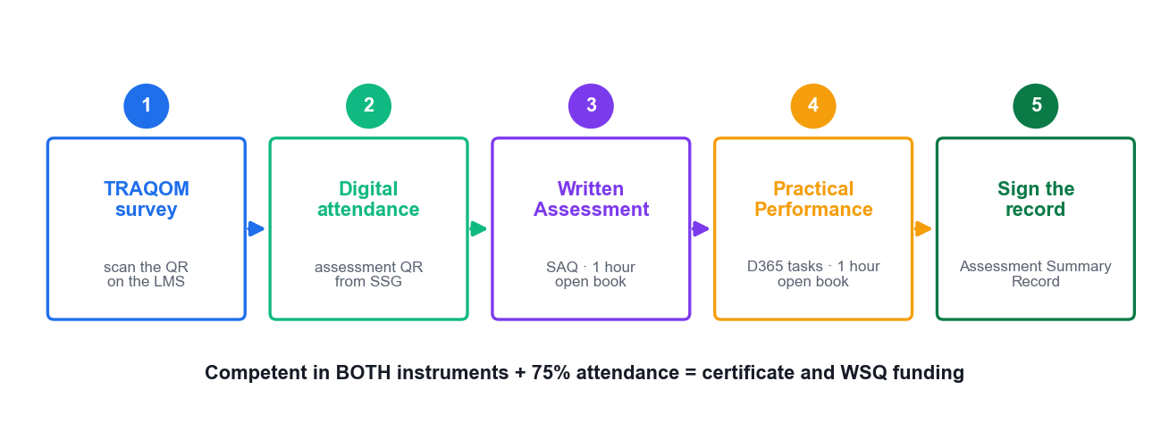
ON ASSESSMENT DAY
Assessment Flow
Survey → attendance → Written Assessment → Practical Performance → sign the Assessment Summary Record.
Microsoft Dynamics 365 Fundamentals (CRM) (MB-910) · TGS-2023040481
© 2026 Tertiary Infotech Academy Pte Ltd
19

Slide 20
WSQ FUNDING REQUIREMENTS
Criteria for Funding
75% minimum attendance
Based on the SSG digital attendance record — AM, PM and assessment, both days.
Assessed 'Competent'
In BOTH the Written Assessment and the Practical Performance.
1
2
Complete the TRAQOM survey
The mandatory post-course survey on the LMS/TMS portal.
Then you receive
A Tertiary Infotech Certificate of Achievement and an SSG OpenCert.
3
4
Microsoft Dynamics 365 Fundamentals (CRM) (MB-910) · TGS-2023040481
© 2026 Tertiary Infotech Academy Pte Ltd
20

Slide 21
LET'S BEGIN
Day 1
Core capabilities, shared activities and the Customer Insights apps.
Microsoft Dynamics 365 Fundamentals (CRM) (MB-910) · TGS-2023040481
© 2026 Tertiary Infotech Academy Pte Ltd
21

Slide 22
01
TOPIC 01
Foundations of Dynamics 365 Customer Engagement Apps
CRM concepts · Power Platform · Microsoft Dataverse · the five CE apps · Copilot · navigation
Microsoft Dynamics 365 Fundamentals (CRM) (MB-910) · TGS-2023040481
© 2026 Tertiary Infotech Academy Pte Ltd
22

Slide 23
THE FOUNDATION OF EVERYTHING THAT FOLLOWS
What Is Customer Relationship Management?
A customer is an entity you serve
Any entity receiving, consuming or purchasing a product or service — an organisation or a person.
Engagement is emotional
The connection between the customer and your brand — CRM exists to build and keep it.
1
2
Engaged customers are worth more
They buy more often, stay longer, cost less to serve and recommend you to others.
CRM is the system of record
One place for every interaction across marketing, sales, service and field operations.
3
4
Not just a contact list
Process, automation, analytics and AI on top of the data — that is what makes it CRM.
The business case
Higher retention, shorter sales cycles, faster resolution, better forecasting.
5
6
Microsoft Dynamics 365 Fundamentals (CRM) (MB-910) · TGS-2023040481
© 2026 Tertiary Infotech Academy Pte Ltd
23

Slide 24
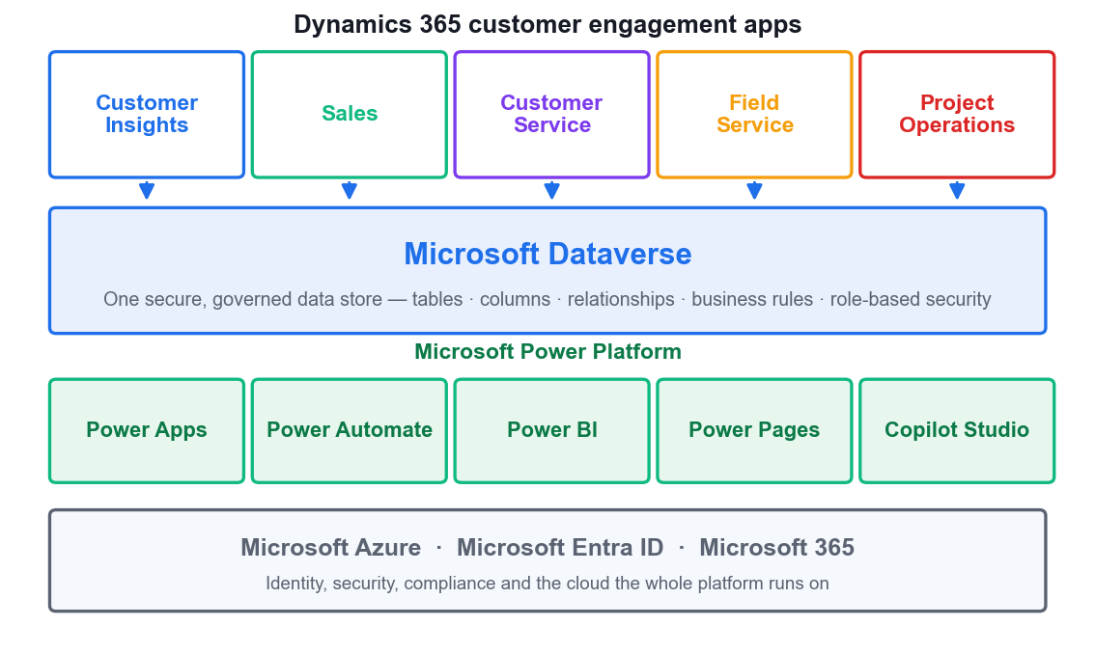
ONE PLATFORM, MANY APPS
Power Platform, Dataverse and the CE Apps
Apps on top
The five customer engagement apps are model-driven Power Apps — licensed separately, deployed modularly.
Dataverse in the middle
One secure, governed database. Every app reads and writes the same rows.
Power Platform underneath
Power Apps, Power Automate, Power BI, Power Pages and Copilot Studio extend every app.
Azure at the base
Entra ID identity, security, compliance and the global cloud infrastructure.
Microsoft Dynamics 365 Fundamentals (CRM) (MB-910) · TGS-2023040481
© 2026 Tertiary Infotech Academy Pte Ltd
24

Slide 25
THE BENEFITS OF A SHARED DATA STORE
Why Dataverse Matters
Easy to manage
Metadata and data are stored together in the cloud — no schema to maintain by hand.
Easy to secure
Role-based security controls access to tables, rows and even individual columns.
1
2
Rich metadata
Data types, relationships and behaviour are used directly by apps and reports.
Logic and validation
Business rules, calculated columns, workflows and duplicate detection run in the data layer.
3
4
Productivity tools
Available as an add-in for Excel and Outlook, so users work where they already are.
One source of truth
Change a customer's address once and every app sees it immediately.
5
6
Microsoft Dynamics 365 Fundamentals (CRM) (MB-910) · TGS-2023040481
© 2026 Tertiary Infotech Academy Pte Ltd
25

Slide 26
MODULAR — LICENSE WHAT YOU NEED
The Five Customer Engagement Apps
App
What it does
Primary user
Core record
Customer Insights – Journeys
Multi-channel marketing campaigns and customer journeys
Marketer
Journey, segment
Customer Insights – Data
Unifies data from many sources into one customer profile
Data analyst
Unified profile
Sales
Manages the pipeline from lead through to invoice
Seller
Lead, opportunity
Customer Service
Handles customer issues to resolution across channels
Support agent
Case
Field Service
Schedules and completes work at the customer's site
Dispatcher, technician
Work order
Project Operations
Runs project-based sales, resourcing and delivery
Project manager
Project
All six share the same Dataverse: a contact created in Sales is the same contact the service agent sees.
Microsoft Dynamics 365 Fundamentals (CRM) (MB-910) · TGS-2023040481
© 2026 Tertiary Infotech Academy Pte Ltd
26

Slide 27
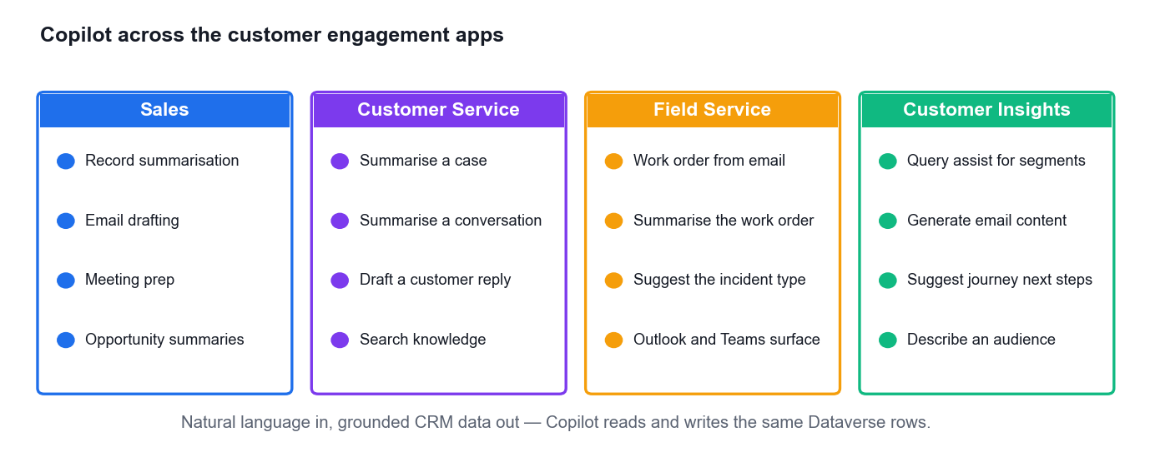
AI EMBEDDED IN EVERY APP
Copilot Across Dynamics 365
Natural language in
Ask in plain English; Copilot works against your real, permission-trimmed CRM data.
Summarise anything
Records, cases, conversations and long email threads condensed to what matters.
Draft the next action
Emails, replies, work orders and marketing content generated in context.
Always review
Copilot proposes, the human decides — every suggestion is editable before it is saved.
Microsoft Dynamics 365 Fundamentals (CRM) (MB-910) · TGS-2023040481
© 2026 Tertiary Infotech Academy Pte Ltd
27

Slide 28
ONE DATA SET, MANY ENTRY POINTS
Ways to Access Dynamics 365
Web browser
The full model-driven app experience — the primary way most users work.
Mobile apps
Dedicated Sales and Field Service apps optimised for phones and offline use.
1
2
Microsoft Outlook
The Dynamics 365 App for Outlook tracks email and shows CRM context in the inbox.
Microsoft Teams
The collaboration hub — pin records to channels, chat in context, share files.
3
4
Power Pages portals
External sites that let customers and partners read and write CRM data safely.
Search from anywhere
Dataverse search finds records across tables from a single search box.
5
6
Microsoft Dynamics 365 Fundamentals (CRM) (MB-910) · TGS-2023040481
© 2026 Tertiary Infotech Academy Pte Ltd
28

Slide 29
TOPIC 01 · HANDS-ON LAB
LAB 1 · 45 MIN
Lab 1 — Navigate Dynamics 365 and Explore Dataverse
You are a new CRM analyst at Contoso Coffee Singapore. Before you can advise on CRM investment you must know what is actually deployed. Sign in to the Power Platform admin centre, identify the environment and its Dataverse database, open the Sales Hub and Customer Service Hub apps, and map how the five customer engagement apps share one data store. You finish by recording an environment inventory your team can act on.
1
2
3
4
5
▶
▶
▶
▶
Sign in to the Power Platform admin center
Inspect the environment and its Dataverse database
Open the Sales Hub and switch apps from the app launcher
Explore Dataverse tables, columns and relationships
Record the environment inventory and navigation map
YOU'LL PRODUCE An environment inventory table (environment name, type, region, Dataverse URL, installed CE apps, security roles) plus an annotated navigation map screenshot set.
Tools: Power Platform admin center, make.powerapps.com, Dynamics 365 Sales Hub, Customer Service Hub, Dataverse · Full step-by-step: Learner Guide, Lab 1
Microsoft Dynamics 365 Fundamentals (CRM) (MB-910) · TGS-2023040481
© 2026 Tertiary Infotech Academy Pte Ltd
29

Slide 30
02
TOPIC 02
Shared Activities and Integration Options
Accounts & contacts · activities · search & filters · views, charts and dashboards · Excel, Teams and Outlook integration
Microsoft Dynamics 365 Fundamentals (CRM) (MB-910) · TGS-2023040481
© 2026 Tertiary Infotech Academy Pte Ltd
30

Slide 31
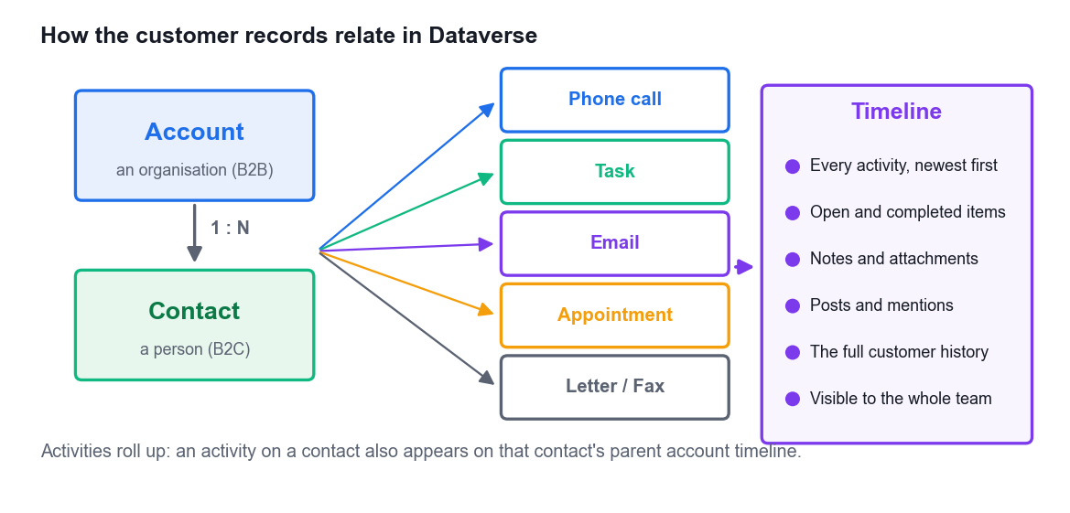
HOW THE CUSTOMER IS MODELLED
Accounts, Contacts and Activities
Account = organisation
The company you do business with — used in B2B scenarios.
Contact = person
An individual — used in B2C, and related to a parent account in B2B.
Hybrid uses both
Most organisations sell to companies AND to individuals; Dynamics 365 supports both at once.
Activities are the history
Phone calls, tasks, emails, appointments, letters and faxes — all on the timeline.
Microsoft Dynamics 365 Fundamentals (CRM) (MB-910) · TGS-2023040481
© 2026 Tertiary Infotech Academy Pte Ltd
31

Slide 32
THREE CUSTOMER MODELS
B2B, B2C and Hybrid
B2B — account-led
B2C — contact-led
• Business-to-Business (B2B)
– You sell to organisations
– The ACCOUNT is the customer
– Contacts are the people at that account
– Longer cycles, multiple stakeholders, quotes and contracts
– Example: Contoso sells espresso machines to hotel groups
• Business-to-Consumer (B2C)
– You sell to individuals
– The CONTACT is the customer
– No parent account required
– Higher volume, shorter cycles, self-service
– Hybrid: many organisations run both models in one Dataverse
The Customer lookup field on cases, opportunities and work orders accepts EITHER an account or a contact — that is what makes hybrid possible.
Microsoft Dynamics 365 Fundamentals (CRM) (MB-910) · TGS-2023040481
© 2026 Tertiary Infotech Academy Pte Ltd
32

Slide 33
EVERY TOUCH IS AN ACTIVITY
The Six Activity Types
Phone call
An inbound or outbound call — logged with direction, duration and outcome.
Task
A to-do with an owner and a due date — the workhorse follow-up activity.
Email
Sent, received or drafted — tracked automatically when Outlook integration is on.
1
2
3
Appointment
A meeting with a time, duration, location and required/optional attendees.
Letter
Physical correspondence recorded for a complete history.
Fax
Retained for regulated industries that still require it.
4
5
6
Microsoft Dynamics 365 Fundamentals (CRM) (MB-910) · TGS-2023040481
© 2026 Tertiary Infotech Academy Pte Ltd
33

Slide 34
TWO DIFFERENT JOBS
Filtering vs Searching
Filter
Search
• Filtering — narrow what you can see
– You are already in a view or list
– Filter on column headers, or use a view's built-in filters
– Fast, broad results within ONE table
– Use when: 'show me only the Singapore accounts'
• Searching — find what you cannot see
– Search a View — text search inside the current view
– Dataverse multi-table search — one box, many tables at once
– Returns accounts, contacts, cases, activities together
– Use when: 'find anything mentioning Marina Bay'
Advanced Find sits above both: a visual query designer that builds criteria across related tables and saves the result as a reusable personal view.
Microsoft Dynamics 365 Fundamentals (CRM) (MB-910) · TGS-2023040481
© 2026 Tertiary Infotech Academy Pte Ltd
34

Slide 35
THE REPORTING STACK
Views, Charts and Dashboards
Views
Charts
Dashboards
• A saved, filtered list of records from ONE table.
• System views are shared; personal views are yours (and shareable).
• Define the columns, the filter criteria and the sort order.
• The foundation — a chart and a dashboard both start from a view.
• A visualisation of the data in a view.
• Interactive — click a bar or segment and the underlying list filters to it.
• Column, bar, pie, funnel, line and tag charts.
• Drill down without writing a single query.
• A combination of charts, views, iframes and web resources.
• Up to six components in one at-a-glance screen.
• System dashboards for the team; personal dashboards for you.
• Power BI goes further: cross-source, richer visuals, scheduled refresh.
Microsoft Dynamics 365 Fundamentals (CRM) (MB-910) · TGS-2023040481
© 2026 Tertiary Infotech Academy Pte Ltd
35

Slide 36
A NATIVE DYNAMICS 365 CHART
Reading a Chart — Cases by Origin
Phone still leads
142 cases — but it is the most expensive channel to staff.
Chat is growing
96 cases at a fraction of the cost per contact.
Social is small
27 cases — but publicly visible, so response time matters most.
The decision
Deflect phone volume to chat and self-service knowledge.
WHAT THE DATA SHOWS Charts are interactive — clicking the Phone column filters the case list to just those 142 records.
Microsoft Dynamics 365 Fundamentals (CRM) (MB-910) · TGS-2023040481
© 2026 Tertiary Infotech Academy Pte Ltd
36

Slide 37
EXPORT THE RIGHT WAY
Excel Integration — Two Modes
Static — a snapshot
Dynamic — a live link
• Static worksheet
– A point-in-time snapshot of the data
– No link back to Dataverse — it never refreshes
– Use for: an ad-hoc analysis, an emailed extract, an archive
– Risk: it is stale the moment it is created
• Dynamic worksheet / PivotTable
– Keeps a live link to the Dataverse data
– Refresh in Excel to pull the current records
– Excel templates: pre-built reports with formulas and charts already in place
– Users get up-to-date reports without knowing Excel formulas
Excel templates let a power user build the report once; everyone else just opens it against their own filtered data.
Microsoft Dynamics 365 Fundamentals (CRM) (MB-910) · TGS-2023040481
© 2026 Tertiary Infotech Academy Pte Ltd
37

Slide 38
MEET USERS WHERE THEY ALREADY WORK
Microsoft Teams and Outlook Integration
Teams collaboration hub
Pin a Dynamics 365 record or view into a channel tab so the whole team works from it.
Teams file integration
Documents on a record are stored in the connected SharePoint site and surfaced in Teams.
1
2
Embedded Teams chat
Start a chat about a record from inside Dynamics 365, with the record's context attached.
Outlook: track email
Link an email, meeting or appointment to a Dynamics 365 record with a single click.
3
4
Outlook: see CRM context
View contact, lead and opportunity information in the reading pane without switching apps.
Outlook: create records
Add a phone call, task or appointment — or a whole new contact — straight from an email.
5
6
Microsoft Dynamics 365 Fundamentals (CRM) (MB-910) · TGS-2023040481
© 2026 Tertiary Infotech Academy Pte Ltd
38

Slide 39
TOPIC 02 · HANDS-ON LAB
LAB 2 · 60 MIN
Lab 2 — Manage Customers, Activities and Reporting Views
Contoso Coffee Singapore is onboarding a new B2B customer. You create the account and its contacts, log the full set of activities on the timeline, then build the reporting layer your manager needs: a filtered personal view via Advanced Find, a chart from that view, and a dashboard combining both. Finally you export to Excel and confirm the Outlook and Teams integration points.
1
2
3
4
5
▶
▶
▶
▶
Create the account and its related contacts
Log phone, task, email and appointment activities
Build a filtered personal view with Advanced Find
Create a chart and a personal dashboard from that view
Export to Excel and check Teams/Outlook integration
YOU'LL PRODUCE An Account with 3 related Contacts, 4 completed/open activities on the timeline, a saved personal view, a chart, a personal dashboard, and a dynamic Excel export.
Tools: Dynamics 365 Sales Hub, Dataverse, Advanced Find, Excel, Microsoft Teams, Outlook · Full step-by-step: Learner Guide, Lab 2
Microsoft Dynamics 365 Fundamentals (CRM) (MB-910) · TGS-2023040481
© 2026 Tertiary Infotech Academy Pte Ltd
39

Slide 40
03
TOPIC 03
Dynamics 365 Customer Insights – Journeys
Marketing use cases · email marketing · segments and marketing lists · customer journeys · lead generation · forms and events
Microsoft Dynamics 365 Fundamentals (CRM) (MB-910) · TGS-2023040481
© 2026 Tertiary Infotech Academy Pte Ltd
40

Slide 41
THE MARKETING APP
What Customer Insights – Journeys Does
Find the right prospects
Identify and score leads so sales spends time on the ones most likely to buy.
Run multi-channel campaigns
Email, SMS, push notifications and custom channels from one journey.
1
2
Nurture with personal journeys
Each contact gets content matched to what they have actually done.
Capture leads on forms
Landing pages, subscription centres and forward-to-a-friend forms feed the funnel.
3
4
Run events end to end
Planning, registration, sessions, speakers, venues and post-event follow-up.
Prove the return
Marketing ROI dashboards connect spend to pipeline and revenue.
5
6
Microsoft Dynamics 365 Fundamentals (CRM) (MB-910) · TGS-2023040481
© 2026 Tertiary Infotech Academy Pte Ltd
41

Slide 42
TWO MARKETING MODELS
Real-Time vs Outbound Marketing
Real-time — reactive
Outbound — planned
• Real-time marketing
– TRIGGER-based: reacts to a signal as it happens
– Journeys start when a contact does something
– Channels: email, SMS, push, custom
– Best for: B2C, high volume, behavioural reaction
– Example: cart abandoned → recovery email in 20 minutes
• Outbound marketing
– SEGMENT-based: planned campaigns on a schedule
– Journeys start when a contact joins a segment
– Deep B2B features: lead scoring, sales hand-off, LinkedIn
– Best for: B2B nurture, events, newsletters
– Example: quarterly product launch to the hospitality segment
Microsoft is consolidating on real-time marketing; know both, because most tenants still run a mix.
Microsoft Dynamics 365 Fundamentals (CRM) (MB-910) · TGS-2023040481
© 2026 Tertiary Infotech Academy Pte Ltd
42

Slide 43
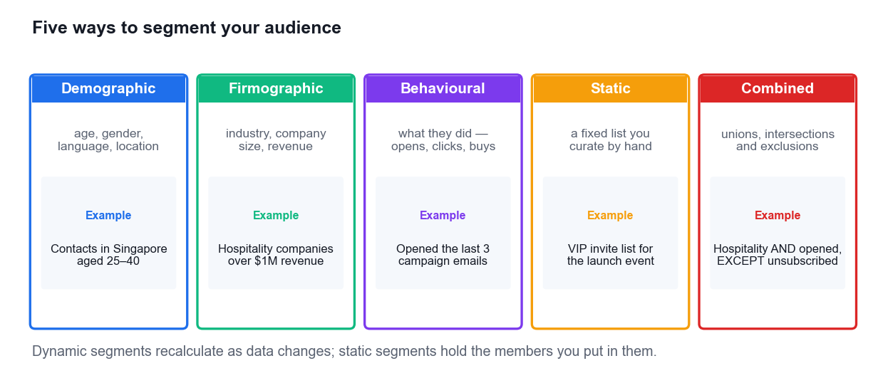
TARGETING
Five Ways to Segment Your Audience
Marketing lists are the static cousin of segments — a fixed membership you curate, carried over from the classic marketing model.
Microsoft Dynamics 365 Fundamentals (CRM) (MB-910) · TGS-2023040481
© 2026 Tertiary Infotech Academy Pte Ltd
43

Slide 44
THE EMAIL DESIGNER
Email Marketing — What the Designer Gives You
Drag-and-drop layout
Add and arrange text, images, buttons, dividers and columns without HTML.
Brand styling
Fonts, colours, backgrounds and reusable brand profiles keep every send on-brand.
1
2
Dynamic personalisation
Insert contact fields with fallback values — 'Hi Priya' or 'Hi there' if the name is blank.
Conditional content
Show different blocks to different audiences from within one email.
3
4
Tracked links
Every link is measured — opens and clicks feed journey branches and segments.
Compliance built in
A physical address and an unsubscribe link are REQUIRED before you can publish.
5
6
Microsoft Dynamics 365 Fundamentals (CRM) (MB-910) · TGS-2023040481
© 2026 Tertiary Infotech Academy Pte Ltd
44

Slide 45
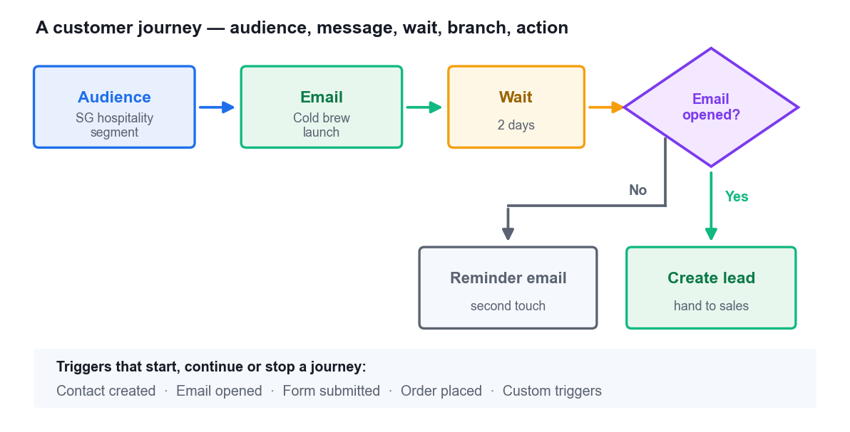
THE JOURNEY CANVAS
Designing a Customer Journey
Start with the audience
A segment (planned) or a trigger (reactive) defines who enters the journey.
Add messages
Email, SMS or push — each one a tile the contact receives at that point.
Insert waits
Wait a fixed period, wait until a date, or wait for a specific behaviour.
Branch on behaviour
If/then and split tiles send engaged and unengaged contacts down different paths.
End with an action
Create a lead, run a workflow, launch a LinkedIn campaign or raise a sales activity.
Microsoft Dynamics 365 Fundamentals (CRM) (MB-910) · TGS-2023040481
© 2026 Tertiary Infotech Academy Pte Ltd
45

Slide 46
THE BUILDING BLOCKS
The Journey Tiles You Will Use
Category
Tiles
What it does
Audience
Segment · Form submitted · Record updated
Defines who enters the journey and when
Messages
Email · SMS · Push notification · Custom channel
Sends content on the channel you choose
Branches
If/then · Split
Sends contacts down different paths by condition or percentage
Waits
Wait / delay · Wait for · Wait until
Controls the pacing between steps
Actions
Create lead · Run workflow · LinkedIn campaign · Sales activity
Does something in Dataverse or another system
Triggers
Custom · Interaction · Business
Starts, continues or stops a journey in real time
Triggers are the real-time engine: Contact created welcomes a new user; Email opened drives a follow-up; Order placed starts fulfilment communications.
Microsoft Dynamics 365 Fundamentals (CRM) (MB-910) · TGS-2023040481
© 2026 Tertiary Infotech Academy Pte Ltd
46

Slide 47
FILLING AND PRIORITISING THE FUNNEL
Lead Generation and Qualification
Create leads manually
A seller or marketer enters the lead and links it to a new or existing contact.
Import from a file
Map a spreadsheet of prospects to leads, contacts or accounts in bulk.
1
2
Sync from LinkedIn
LinkedIn Lead Gen Forms flow straight into Dynamics 365 as leads.
Capture on a marketing form
A landing page form creates the lead the moment it is submitted.
3
4
Score the lead
Scoring models rank leads by demographic fit and behaviour — sales-ready at a threshold.
Hand off to sales
A sales-ready lead is passed to a seller, who qualifies or disqualifies it.
5
6
Microsoft Dynamics 365 Fundamentals (CRM) (MB-910) · TGS-2023040481
© 2026 Tertiary Infotech Academy Pte Ltd
47

Slide 48
CAPTURE AND CONVENE
Marketing Forms and Event Management
Forms — capture the lead
Events — convene the audience
• Three marketing form types
– Landing page form — captures new leads and contacts
– Subscription form — lets people manage their own preferences
– Forward to a friend — turns a recipient into a referrer
– Forms can prefill known values and match to existing records
• Event management covers the whole event
– Design the event: venue, capacity, budget, dates
– Build the agenda: sessions, tracks and a schedule
– Manage speakers, sponsors and registrations
– Publish an event website and check attendees in
– Follow up: attendance data drives post-event journeys
Both feed the same funnel: a form submission or an event registration can trigger a journey and create a lead.
Microsoft Dynamics 365 Fundamentals (CRM) (MB-910) · TGS-2023040481
© 2026 Tertiary Infotech Academy Pte Ltd
48

Slide 49
TOPIC 03 · HANDS-ON LAB
LAB 3 · 60 MIN
Lab 3 — Build a Segment, an Email and a Customer Journey
Contoso Coffee Singapore is launching a cold-brew range to its Singapore hospitality contacts. You build the targeting segment, design a marketing email with dynamic personalisation, wire both into a customer journey with a trigger and a conditional branch, then create the marketing form and event that capture the resulting leads. This is the full marketing framework the course's LO2 requires.
1
2
3
4
5
▶
▶
▶
▶
Create the audience segment and check its membership
Design and personalise the marketing email
Build the journey with a trigger and a branch
Publish the journey and verify it goes live
Create the marketing form and the event registration
YOU'LL PRODUCE A live segment of Singapore hospitality contacts, a published marketing email, a running customer journey with a branch, a marketing form on a landing page, and an event with a registration record.
Tools: Dynamics 365 Customer Insights – Journeys, Dataverse, email designer, segment builder, event management · Full step-by-step: Learner Guide, Lab 3
Microsoft Dynamics 365 Fundamentals (CRM) (MB-910) · TGS-2023040481
© 2026 Tertiary Infotech Academy Pte Ltd
49

Slide 50
04
TOPIC 04
Customer Insights – Data and Customer Voice
Unified customer profiles · data ingestion, unification, enrichment · measures and segments · survey feedback management
Microsoft Dynamics 365 Fundamentals (CRM) (MB-910) · TGS-2023040481
© 2026 Tertiary Infotech Academy Pte Ltd
50

Slide 51
THE PROBLEM IT SOLVES
The same person, five different systems.
Customer Insights – Data is the customer data platform that resolves them into one profile you can act on.
Microsoft Dynamics 365 Fundamentals (CRM) (MB-910) · TGS-2023040481
© 2026 Tertiary Infotech Academy Pte Ltd
51

Slide 52
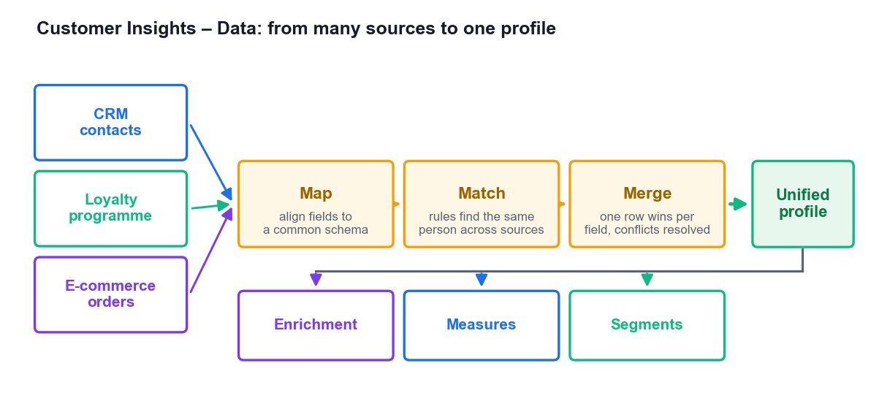
FROM MANY SOURCES TO ONE PROFILE
The Unification Pipeline
Ingest
Connect CRM, ERP, e-commerce, loyalty, web and point-of-sale sources.
Map
Align each source's fields to common semantic types — name, email, phone, address.
Match
Rules decide when two rows are the same person: exact email, then fuzzier fallbacks.
Merge
One value wins per field, using a precedence order you control.
Then activate
Enrich, measure, segment — and push the result into Journeys, Sales and Power BI.
Microsoft Dynamics 365 Fundamentals (CRM) (MB-910) · TGS-2023040481
© 2026 Tertiary Infotech Academy Pte Ltd
52

Slide 53
TURNING A PROFILE INTO INSIGHT
What You Build on the Unified Profile
Activities
Mark ingested tables as activities — purchases, tickets, web visits — with a timestamp.
Relationships
Define how tables relate to the profile so you can traverse the data.
1
2
Enrichment
Add brand affinity, interests, demographics and verified addresses from outside sources.
Measures
KPIs: customer lifetime value per person, or total revenue across the business.
3
4
Predictions
Out-of-the-box models for churn risk, product recommendation and subscription churn.
Segments
Audiences built from any profile attribute, measure or activity — ready to activate.
5
6
Microsoft Dynamics 365 Fundamentals (CRM) (MB-910) · TGS-2023040481
© 2026 Tertiary Infotech Academy Pte Ltd
53

Slide 54
A MEASURE MADE ACTIONABLE
Customer Lifetime Value by Segment
Measures create segments
'CLV > 500' becomes the High value segment you can market to.
The tail is long
Occasional and dormant customers are the majority by count.
Target the middle
Growing customers respond best to upsell — they already buy.
Act on at-risk
Feed that segment into a win-back journey before they go dormant.
WHAT THE DATA SHOWS The measure defines the segment; the segment drives the journey — this is how data becomes marketing action.
Microsoft Dynamics 365 Fundamentals (CRM) (MB-910) · TGS-2023040481
© 2026 Tertiary Infotech Academy Pte Ltd
54

Slide 55
CAPTURING THE CUSTOMER'S VOICE
Dynamics 365 Customer Voice
Enterprise feedback management
Design, distribute and analyse surveys at scale, integrated with Dataverse.
Four ways to distribute
Email, a shareable link, a QR code, or embedded in a web page or app.
1
2
The metrics that matter
Customer satisfaction (CSAT), Net Promoter Score (NPS) and custom sentiment measures.
Responses are Dataverse rows
So they appear on the customer record and on service dashboards.
3
4
Automate the follow-up
A low score can trigger a journey, raise a case or alert an account manager.
Close the loop
Feedback drives the decisions — what to fix, what to build, how to serve.
5
6
Microsoft Dynamics 365 Fundamentals (CRM) (MB-910) · TGS-2023040481
© 2026 Tertiary Infotech Academy Pte Ltd
55

Slide 56
GETTING RESPONSES YOU CAN TRUST
Survey Design — Six Best Practices
Define one objective
Know what decision the results will inform before you write a question.
Keep it short
Completion rates fall sharply after about five questions.
1
2
Create a logical flow
Group related questions; move from general to specific.
Organise into pages
Use sections and branching so people only see relevant questions.
3
4
Preview before you send
Test on desktop AND mobile — most responses arrive on a phone.
Set expectations
Say how long it takes and what you will do with the answers.
5
6
Microsoft Dynamics 365 Fundamentals (CRM) (MB-910) · TGS-2023040481
© 2026 Tertiary Infotech Academy Pte Ltd
56

Slide 57
TOPIC 04 · HANDS-ON LAB
LAB 4 · 45 MIN
Lab 4 — Unify Customer Data and Capture Feedback with Customer Voice
Contoso's loyalty data, e-commerce orders and CRM contacts describe the same people under different keys. You walk the Customer Insights – Data unification pipeline to produce one profile per customer, define a lifetime-value measure and a high-value segment, then build and distribute a Customer Voice satisfaction survey and read the results. This gives you the customer insight LO4 asks you to draw.
1
2
3
4
5
▶
▶
▶
▶
Ingest the three source data sets
Map, match and merge to unified profiles
Define activities and a lifetime-value measure
Build a high-value segment from the measure
Create, send and analyse a Customer Voice survey
YOU'LL PRODUCE A unified customer profile set from three sources, a customer lifetime-value measure, a high-value segment, and a published Customer Voice survey with a satisfaction metric.
Tools: Dynamics 365 Customer Insights – Data, Dataverse, Dynamics 365 Customer Voice, Power BI · Full step-by-step: Learner Guide, Lab 4
Microsoft Dynamics 365 Fundamentals (CRM) (MB-910) · TGS-2023040481
© 2026 Tertiary Infotech Academy Pte Ltd
57

Slide 58
RECAP & Q&A
End of Day 1
Tomorrow: Sales, Customer Service and Field Service — then the assessment.
Microsoft Dynamics 365 Fundamentals (CRM) (MB-910) · TGS-2023040481
© 2026 Tertiary Infotech Academy Pte Ltd
58

Slide 59
WELCOME BACK
Day 2
Sales, Customer Service, Field Service — and the final assessment.
Microsoft Dynamics 365 Fundamentals (CRM) (MB-910) · TGS-2023040481
© 2026 Tertiary Infotech Academy Pte Ltd
59

Slide 60
05
TOPIC 05
Explore Dynamics 365 Sales
Sales use cases · the sales lifecycle · leads and qualification · opportunity management · quotes, orders, invoices · business process flows · sales accelerator
Microsoft Dynamics 365 Fundamentals (CRM) (MB-910) · TGS-2023040481
© 2026 Tertiary Infotech Academy Pte Ltd
60

Slide 61
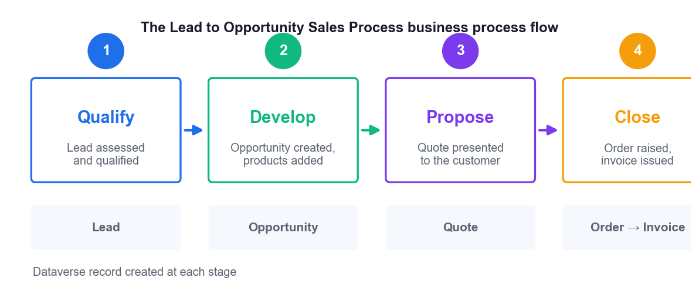
FIVE STAGES, FIVE RECORDS
The Sales Lifecycle
Qualify
A lead is assessed: is there a real need, budget, authority and timeline?
Develop
An opportunity is created with products, estimated revenue, stakeholders and competitors.
Propose
A quote prices the products and is formally presented to the customer.
Close
The customer commits: the quote is won, an order is raised and an invoice issued.
A record at each stage
Lead → Opportunity → Quote → Order → Invoice, each linked to the last.
Microsoft Dynamics 365 Fundamentals (CRM) (MB-910) · TGS-2023040481
© 2026 Tertiary Infotech Academy Pte Ltd
61

Slide 62
TOOLS THAT MOVE DEALS FORWARD
What Dynamics 365 Sales Gives the Seller
AI-assisted qualification
Predictive scoring ranks leads and opportunities by likelihood to convert.
Tailorable process flows
The organisation's own sales process, enforced at the top of every form.
1
2
The Assistant
Action cards surface what needs attention today — no deal goes quiet unnoticed.
The Timeline
Every call, email, meeting and note against the customer, newest first.
3
4
Product catalog
Unit groups, price lists and discount lists produce consistent, controlled pricing.
Embedded collaboration
Teams, Outlook, SharePoint, OneDrive and Office documents in the flow of work.
5
6
Microsoft Dynamics 365 Fundamentals (CRM) (MB-910) · TGS-2023040481
© 2026 Tertiary Infotech Academy Pte Ltd
62

Slide 63
THE CRITICAL DISTINCTION
Leads vs Opportunities
Lead — viability
Opportunity — revenue
• Lead — is this worth pursuing?
– An unqualified prospect: a name, a company, an interest
– Goal: determine VIABILITY
– Gather information, make contact, decide
– Outcome: Qualified (creates account, contact, opportunity) or Disqualified
– Disqualify reasons: lost, cannot contact, no longer interested, cancelled
• Opportunity — how much and when?
– A qualified deal you are actively working
– Goal: WIN the revenue
– Estimated revenue, close date, products, probability
– Stakeholders, competitors, sales team, quotes
– Outcome: Won (actual revenue recorded) or Lost (with a reason)
Qualifying a lead is a one-way door: Dynamics 365 creates the downstream records and closes the lead as Qualified.
Microsoft Dynamics 365 Fundamentals (CRM) (MB-910) · TGS-2023040481
© 2026 Tertiary Infotech Academy Pte Ltd
63

Slide 64
THE DISCIPLINE THAT WINS DEALS
Managing an Opportunity Well
Assign and share
Give it to the right seller or team; add a sales team for collaborative deals.
Track products
Line items from the catalog, or write-in products for one-off requirements.
1
2
Attach literature
Send the customer the right brochures, specs and case studies.
Record stakeholders
Who decides, who influences, who blocks — and their role on the deal.
3
4
Log competitors
Who else is bidding, and the strengths and weaknesses you must answer.
Keep the close date honest
The forecast is only as good as the dates sellers maintain.
5
6
Microsoft Dynamics 365 Fundamentals (CRM) (MB-910) · TGS-2023040481
© 2026 Tertiary Infotech Academy Pte Ltd
64

Slide 65
SALES ORDER PROCESSING
Quote → Order → Invoice
1
2
3
4
5
▶
▶
▶
▶
DRAFT quote: build the line items, pricing and discounts
ACTIVATE the quote: it becomes read-only and is sent to the customer
REVISE if the customer negotiates — this creates a new revision
WIN the quote: the customer accepts and an ORDER is created
INVOICE the order, then mark it paid — Complete (in full) or Partial
A quote defines pricing and quantities. An order is the customer's commitment to buy. An invoice is the request for payment.
Microsoft Dynamics 365 Fundamentals (CRM) (MB-910) · TGS-2023040481
© 2026 Tertiary Infotech Academy Pte Ltd
65

Slide 66
GUIDING PEOPLE THROUGH THE PROCESS
Business Process Flows
Stages and steps
A stage is a phase of work; steps are the fields that must be completed within it.
Always visible
The flow sits at the top of the form, so the next action is never in doubt.
1
2
Consistent execution
New sellers follow the same proven process as the experienced ones.
Cross-table
One flow can span lead → opportunity → quote, carrying context across records.
3
4
Configurable, not code
Business analysts change the process without a developer.
The default flow
'Lead to Opportunity Sales Process' — Qualify, Develop, Propose, Close.
5
6
Microsoft Dynamics 365 Fundamentals (CRM) (MB-910) · TGS-2023040481
© 2026 Tertiary Infotech Academy Pte Ltd
66

Slide 67
MINIMISING THE TIME BETWEEN SALES ACTIONS
The Sales Accelerator
One prioritised work list
The seller opens one screen and knows exactly who to contact next.
Sequences
A defined set of consecutive activities — call, wait, email, wait, LinkedIn — applied to records.
1
2
Multi-channel from one place
Phone, email, SMS and LinkedIn actions without leaving the workspace.
Context travels with you
The record, its timeline and the customer's history sit beside the action.
3
4
Sequence analytics
Monitor which steps convert and which are ignored, then improve the sequence.
Less searching, more selling
The measurable win: time spent deciding who to call drops to near zero.
5
6
Microsoft Dynamics 365 Fundamentals (CRM) (MB-910) · TGS-2023040481
© 2026 Tertiary Infotech Academy Pte Ltd
67

Slide 68
TOPIC 05 · HANDS-ON LAB
LAB 5 · 60 MIN
Lab 5 — Run the Lead-to-Cash Cycle: Lead, Opportunity, Quote, Order
Suzanne Burke of Contoso - Washington has enquired about new espresso equipment. You take that enquiry through the entire sales lifecycle: capture the lead, work the Lead to Opportunity business process flow, qualify it into an opportunity, add products from the catalog, generate a quote, activate and win it, convert to an order and raise the invoice. This is the LO1/LO3 backbone of the course.
1
2
3
4
5
▶
▶
▶
▶
Create the lead and complete the Qualify stage
Log activities and qualify into an opportunity
Add catalog products and estimated revenue
Create, activate and win the quote
Convert to an order and generate the invoice
YOU'LL PRODUCE A qualified lead, an opportunity with product line items and estimated revenue, an activated and won quote, a sales order and an invoice — with the business process flow advanced to Close.
Tools: Dynamics 365 Sales Hub, Dataverse, business process flows, product catalog, quotes, orders, invoices · Full step-by-step: Learner Guide, Lab 5
Microsoft Dynamics 365 Fundamentals (CRM) (MB-910) · TGS-2023040481
© 2026 Tertiary Infotech Academy Pte Ltd
68

Slide 69
06
TOPIC 06
Dynamics 365 Sales Capabilities and Related Apps
Sales pipeline and forecasting · Sales Insights (standard vs premium) · LinkedIn Sales Navigator · the Sales mobile app · Microsoft 365 Copilot for Sales
Microsoft Dynamics 365 Fundamentals (CRM) (MB-910) · TGS-2023040481
© 2026 Tertiary Infotech Academy Pte Ltd
69

Slide 70
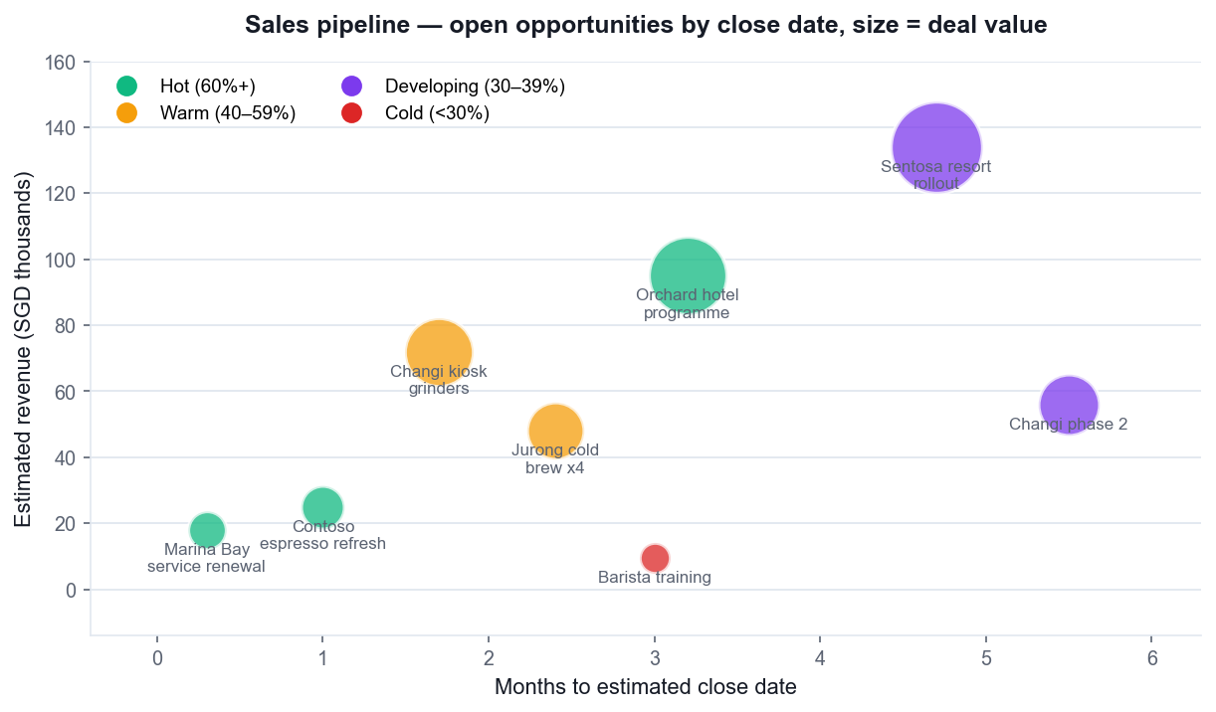
THE LEADING INDICATOR
Reading the Pipeline
Position = time
Deals are plotted by estimated close date — the near-term crunch is visible instantly.
Size = value
The bigger the circle, the bigger the deal. Two big circles can outweigh twenty small ones.
Colour = confidence
Rating or predictive score — hot deals in one colour, cold in another.
What to look for
A quarter with no large deals closing is a forecast problem you can still fix.
Microsoft Dynamics 365 Fundamentals (CRM) (MB-910) · TGS-2023040481
© 2026 Tertiary Infotech Academy Pte Ltd
70

Slide 71
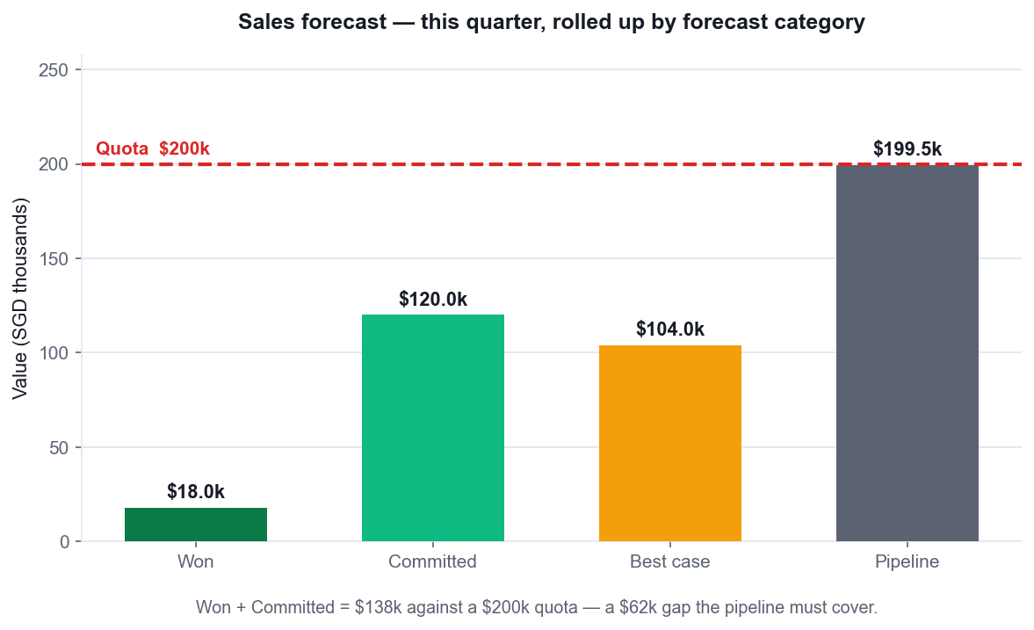
PREDICTING THE PERIOD
Forecasting the Quarter
Forecast categories
Pipeline, Best Case, Committed, Won and Omitted — each opportunity sits in one.
Roll-up by hierarchy
Seller → manager → director, so every level sees its own number.
Adjustments are tracked
A manager's override is recorded separately from the system roll-up.
The gap is the message
Won + Committed against quota tells you how hard the rest of the quarter is.
Microsoft Dynamics 365 Fundamentals (CRM) (MB-910) · TGS-2023040481
© 2026 Tertiary Infotech Academy Pte Ltd
71

Slide 72
WHO DEPENDS ON THE NUMBER
Why Accurate Forecasting Matters
Sellers
Know whether they will hit quota with time left to do something about it.
Sales managers
Spot the gap early, reallocate effort, and coach the deals that matter.
1
2
Sales leaders
Commit a number to the business that operations and finance can plan against.
Enablement managers
See which behaviours and sequences actually correlate with won deals.
3
4
The business
Inventory, hiring and cash flow all depend on the forecast being believable.
The test
Compare committed forecast to actual won, period after period — that is forecast accuracy.
5
6
Microsoft Dynamics 365 Fundamentals (CRM) (MB-910) · TGS-2023040481
© 2026 Tertiary Infotech Academy Pte Ltd
72

Slide 73
THE INVESTMENT DECISION
Sales Insights — Standard vs Premium
Feature
Standard (included)
Premium (licensed)
What it gives you
Assistant
Yes
With Studio
Action cards telling the seller what needs attention
Auto capture
Basic
Premium
Suggests untracked emails and meetings for the timeline
Email engagement
Yes
Yes
Open, click and reply tracking on sent emails
Sequences
Yes
Yes
Consecutive activity sets applied to leads and opportunities
Relationship analytics
—
Yes
Health scores and KPIs on every customer relationship
Predictive lead scoring
—
Yes
AI ranks leads by likelihood to convert
Predictive opportunity scoring
—
Yes
AI ranks open deals by likelihood to close
Conversation intelligence
—
Yes
Analyses sales calls for sentiment, keywords and coaching
This table IS the investment recommendation: which premium capabilities solve a problem you actually have?
Microsoft Dynamics 365 Fundamentals (CRM) (MB-910) · TGS-2023040481
© 2026 Tertiary Infotech Academy Pte Ltd
73

Slide 74
THE PERSON BEHIND THE RECORD
LinkedIn Sales Navigator Integration
Top card
Headline profile information for the lead or account, embedded in the D365 form.
News and icebreakers
Recent activity and shared interests that give the seller a reason to reach out.
1
2
Connections
See who in your organisation already knows this person — and ask for an introduction.
Related leads
Other decision-makers at the same account you have not yet engaged.
3
4
Recommended leads
Sales Navigator suggests prospects matching your ideal customer profile.
Job-change alerts
A contact moving to a new company is a new opportunity — and a churn risk.
5
6
Microsoft Dynamics 365 Fundamentals (CRM) (MB-910) · TGS-2023040481
© 2026 Tertiary Infotech Academy Pte Ltd
74

Slide 75
SELLING AWAY FROM THE DESK
Mobile and Copilot for Sales
Mobile — the field
Copilot — the inbox
• Dynamics 365 Sales mobile app
– Plan your day — bookings, tasks and priorities on one screen
– Prepare for meetings — the customer's history before you walk in
– Post-meeting work — capture notes by voice, create follow-ups
– Join online meetings directly from the app
– Built for the field seller who is rarely at a desk
• Microsoft 365 Copilot for Sales
– Works INSIDE Outlook and Teams — no app switching
– Summarise a long email thread or a meeting recording
– Draft a reply grounded in the CRM record
– Save updates back to Dynamics 365 without opening it
– Removes the manual data entry sellers most resent
Both target the same problem: sellers spend too much time on admin and not enough with customers.
Microsoft Dynamics 365 Fundamentals (CRM) (MB-910) · TGS-2023040481
© 2026 Tertiary Infotech Academy Pte Ltd
75

Slide 76
TOPIC 06 · HANDS-ON LAB
LAB 6 · 45 MIN
Lab 6 — Forecast the Pipeline and Evaluate Sales Insights
Your sales director wants to know whether to buy the Sales Insights premium add-on. You build the pipeline view and a forecast, work the sales accelerator list, examine which Sales Insights features are included versus licensed, review the LinkedIn Sales Navigator and mobile experiences, and produce a written investment recommendation — exactly the evidence LO5 requires.
1
2
3
4
5
▶
▶
▶
▶
Import the pipeline data and open the pipeline chart
Configure and read a sales forecast
Work the sales accelerator list and apply a sequence
Compare Sales Insights standard vs premium features
Write the investment recommendation
YOU'LL PRODUCE A pipeline chart and forecast for the current period, a sales accelerator work list with a sequence applied, a completed standard-vs-premium feature comparison, and a one-page investment recommendation.
Tools: Dynamics 365 Sales Hub, Sales Insights, forecasting, sales accelerator, LinkedIn Sales Navigator, Copilot for Sales, Power BI · Full step-by-step: Learner Guide, Lab 6
Microsoft Dynamics 365 Fundamentals (CRM) (MB-910) · TGS-2023040481
© 2026 Tertiary Infotech Academy Pte Ltd
76

Slide 77
07
TOPIC 07
Explore Dynamics 365 Customer Service
Service use cases · the case lifecycle · SLAs and entitlements · workload management, queues and routing · business process flows · knowledge management
Microsoft Dynamics 365 Fundamentals (CRM) (MB-910) · TGS-2023040481
© 2026 Tertiary Infotech Academy Pte Ltd
77

Slide 78
EQUIPPING THE AGENT TO RESOLVE
What Dynamics 365 Customer Service Does
Track issues as cases
Every customer problem becomes a case record with a full interaction history.
Share knowledge
A knowledge base agents search and customers self-serve from.
1
2
Route work intelligently
Queues and routing rules put each case in front of the right person.
Enforce service levels
SLAs put a measurable clock on first response and resolution.
3
4
Define what is covered
Entitlements record how much support the customer has actually bought.
Measure and improve
Dashboards and historical analytics show where service is working and where it is not.
5
6
Microsoft Dynamics 365 Fundamentals (CRM) (MB-910) · TGS-2023040481
© 2026 Tertiary Infotech Academy Pte Ltd
78

Slide 79
MANY INDUSTRIES, ONE PATTERN
Where Customer Service Is Used
Scenario
What they handle
Why Dynamics 365 fits
Contact centre
High-volume inbound calls, chat and email
Omnichannel routing, session management, agent scripts
Service centre
Repairs and servicing at a facility
Case tracking with parts, entitlements and warranty terms
Internal IT helpdesk
Employee technology issues
Queues, SLAs, knowledge base and self-service portal
HR service desk
Employee policy and benefit questions
Confidential cases with role-based security
Warranty support
Claims against a purchased product
Entitlements, customer assets and case resolution history
Microsoft Dynamics 365 Fundamentals (CRM) (MB-910) · TGS-2023040481
© 2026 Tertiary Infotech Academy Pte Ltd
79

Slide 80
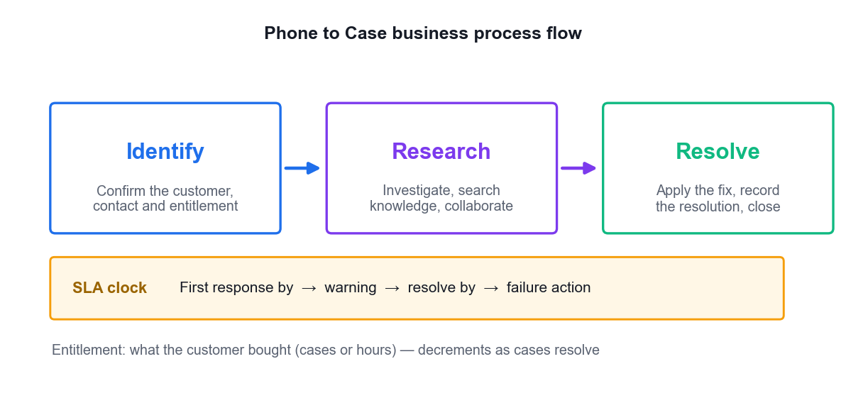
PHONE TO CASE BUSINESS PROCESS FLOW
The Case Lifecycle
Identify
Confirm the customer and contact, check the entitlement, understand the issue.
Research
Investigate, search knowledge, collaborate with colleagues, escalate if needed.
Resolve
Apply the fix, record the resolution type and billable time, close the case.
The SLA runs alongside
First response and resolution clocks with warning and failure actions.
The entitlement decrements
Each resolved case consumes one of the customer's purchased terms.
Microsoft Dynamics 365 Fundamentals (CRM) (MB-910) · TGS-2023040481
© 2026 Tertiary Infotech Academy Pte Ltd
80

Slide 81
TWO WAYS TO MANAGE SERVICE LEVEL
SLAs and Entitlements — Not the Same Thing
SLA — how fast
Entitlement — how much
• Service Level Agreement (SLA)
– A TIME commitment: how fast you will respond and resolve
– KPIs: First Response By, Resolve By
– Warning action fires before the deadline
– Failure action fires when it is breached
– Can differ by priority, customer tier or channel
• Entitlement
– A QUANTITY commitment: how much support they bought
– Allocated by number of cases OR number of hours
– Has a start date, end date and remaining balance
– Can be restricted to specific channels or products
– Covers warranties, service contracts and incident packs
A gold customer might have a 1-hour SLA and a 50-case entitlement; a bronze customer 24 hours and 10 cases.
Microsoft Dynamics 365 Fundamentals (CRM) (MB-910) · TGS-2023040481
© 2026 Tertiary Infotech Academy Pte Ltd
81

Slide 82
SIX ROUTES INTO THE QUEUE
How Cases Get Created
Manually by an agent
The agent takes a call and creates the case as they talk to the customer.
Automatic record creation
Rules turn inbound email, social posts or IoT alerts into cases without human touch.
1
2
Customer self-service
A portal or a bot lets the customer raise the case themselves, any hour.
From a conversation
An Omnichannel chat or call escalates into a case with the transcript attached.
3
4
From a work order
A field visit that reveals a second problem raises a new case.
Via API or integration
Another system (ERP, monitoring, partner portal) creates cases programmatically.
5
6
Microsoft Dynamics 365 Fundamentals (CRM) (MB-910) · TGS-2023040481
© 2026 Tertiary Infotech Academy Pte Ltd
82

Slide 83
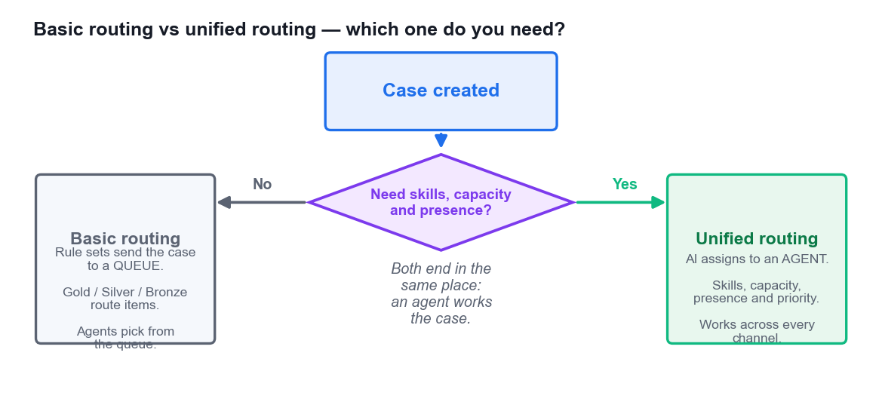
WORKLOAD MANAGEMENT
Queues and Routing
Queues hold the work
Cases sit in a queue until an agent picks one or is assigned it.
Basic routing → a queue
Rule sets (Gold / Silver / Bronze) direct the case to the right queue by criteria.
Unified routing → an agent
AI assigns work using skills, capacity, presence and priority, across every channel.
Choose by complexity
Small team, one channel? Basic. Skills-based, multi-channel? Unified.
Microsoft Dynamics 365 Fundamentals (CRM) (MB-910) · TGS-2023040481
© 2026 Tertiary Infotech Academy Pte Ltd
83

Slide 84
SCALING THE ANSWER
Knowledge Management
Create and design
Rich-text articles with images, videos, attachments and structured templates.
Manage the lifecycle
Draft → review → approve → publish, with scheduled publication dates.
1
2
Version history
Major and minor versions; retire an article without losing the record.
Translate
Language variants so global teams and customers get the same answer.
3
4
Search from the case
The knowledge pane pre-searches using the case title — no retyping.
Link, email or share
Attach the article to the case, email it to the customer, or publish it to the portal.
5
6
Microsoft Dynamics 365 Fundamentals (CRM) (MB-910) · TGS-2023040481
© 2026 Tertiary Infotech Academy Pte Ltd
84

Slide 85
TOPIC 07 · HANDS-ON LAB
LAB 7 · 60 MIN
Lab 7 — Resolve a Case with Knowledge, Queues, SLAs and Entitlements
Alpine Ski House has received a damaged espresso machine. You author and publish the knowledge article that answers it, create the case, route it through a queue, watch the SLA clock, apply an entitlement, work the Phone to Case business process flow, attach the article and resolve the case. This is the complete service lifecycle behind LO1 and LO3.
1
2
3
4
5
▶
▶
▶
▶
Author and publish the knowledge article
Create the case and set its customer and origin
Route it to a queue and apply the SLA and entitlement
Work the Phone to Case BPF and attach the article
Resolve the case and check the resolution record
YOU'LL PRODUCE A published knowledge article, a case routed through a queue with an SLA and an entitlement applied, advanced through all three BPF stages and resolved with the article linked.
Tools: Dynamics 365 Customer Service Hub, Dataverse, knowledge management, queues, routing rules, SLAs, entitlements · Full step-by-step: Learner Guide, Lab 7
Microsoft Dynamics 365 Fundamentals (CRM) (MB-910) · TGS-2023040481
© 2026 Tertiary Infotech Academy Pte Ltd
85

Slide 86
08
TOPIC 08
Customer Service Capabilities and Related Apps
Omnichannel for Customer Service · supervisor experiences and Omnichannel Insights · Customer Voice for service · reporting and data visualisation
Microsoft Dynamics 365 Fundamentals (CRM) (MB-910) · TGS-2023040481
© 2026 Tertiary Infotech Academy Pte Ltd
86

Slide 87
EVERY CHANNEL, ONE WORKSPACE
Omnichannel for Customer Service
Live chat
Website and app chat, with proactive invitations based on visitor behaviour.
SMS
Two-way text conversations through supported SMS providers.
Voice
A full cloud contact centre — inbound and outbound calling with transcription.
1
2
3
Social channels
Facebook, WhatsApp, LINE, WeChat and Twitter/X in the same workspace.
Microsoft Teams
Support employees and partners in the tool they already use all day.
Entity/record channels
Email and case records handled beside the live conversations.
4
5
6
Microsoft Dynamics 365 Fundamentals (CRM) (MB-910) · TGS-2023040481
© 2026 Tertiary Infotech Academy Pte Ltd
87

Slide 88
PRODUCTIVITY IN THE CONVERSATION
What the Agent Workspace Gives You
Session management
Each conversation is its own session with its own tabs — several at once, no lost context.
Real-time notifications
Incoming work arrives with the customer's context already attached.
1
2
Customer context
Who they are, their history, their entitlement and their open cases, at a glance.
AI conversation summary
Copilot condenses a long chat so the next agent is up to speed immediately.
3
4
Smart assist
Suggests relevant knowledge articles and similar resolved cases as the conversation unfolds.
Agent scripts and macros
Guided steps and one-click automations for the procedures that must be exact.
5
6
Microsoft Dynamics 365 Fundamentals (CRM) (MB-910) · TGS-2023040481
© 2026 Tertiary Infotech Academy Pte Ltd
88

Slide 89
THE FIRST LINE OF SUPPORT
Bots and Escalation
Bot — deflect
Human — resolve
• What the bot handles
– Password resets, order status, opening hours, simple how-to
– Available 24/7 at near-zero marginal cost
– Built in Microsoft Copilot Studio, no code required
– Deflects routine volume so humans handle the hard cases
• What happens on escalation
– The bot hands off to a human agent in the same conversation
– The FULL transcript travels with it — the customer never repeats themselves
– Skills-based routing picks the right agent for the topic
– The bot report tells you the deflection rate you are achieving
Measure deflection honestly: a bot that frustrates customers into abandoning is not deflecting, it is losing them.
Microsoft Dynamics 365 Fundamentals (CRM) (MB-910) · TGS-2023040481
© 2026 Tertiary Infotech Academy Pte Ltd
89

Slide 90
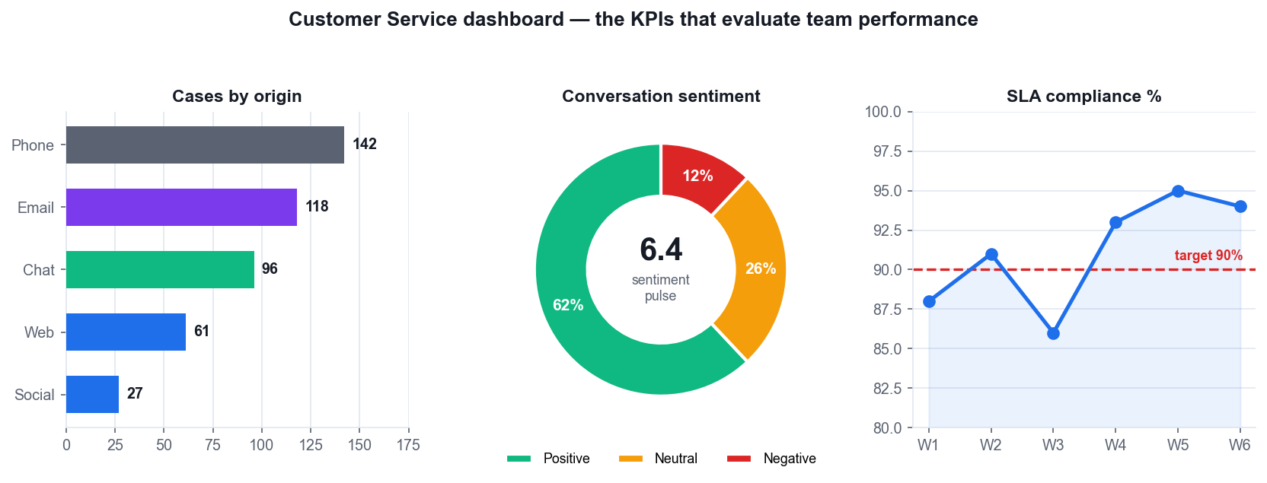
EVALUATING TEAM PERFORMANCE
The Service Dashboard
Volume by channel
Where the work is coming from — and which channels cost the most to staff.
Sentiment in near real time
Average sentiment pulse plus the positive/neutral/negative split.
SLA compliance trend
The percentage met, week by week, against the target you committed to.
Supervisors can intervene
Monitor, assign, transfer or force-close a conversation going wrong.
Filters and bookmarks
Save a filtered view of the dashboard you return to every morning.
Microsoft Dynamics 365 Fundamentals (CRM) (MB-910) · TGS-2023040481
© 2026 Tertiary Infotech Academy Pte Ltd
90

Slide 91
HISTORICAL ANALYTICS
Which Report Answers Which Question
Management question
Report
Key metric
Are we handling more cases than last month?
Customer Service – Summary
Case volume, resolution rate
Which agent needs coaching?
Customer Service – Agent
Cases handled, average handle time
What are customers contacting us about?
Case Topics
AI-clustered case themes
Is the bot deflecting enough?
Omnichannel – Bot
Bot resolution and escalation rate
Are customers waiting too long?
Omnichannel – Queue
Average wait time, abandon rate
Are conversations turning negative?
Sentiment Analysis
Average sentiment pulse, % negative
Are customers satisfied after resolution?
Customer Voice
CSAT and Net Promoter Score
Three Customer Service reports (Summary, Agent, Case Topics) and five Omnichannel reports (Conversation, Queue, Agent, Bot, Topics).
Microsoft Dynamics 365 Fundamentals (CRM) (MB-910) · TGS-2023040481
© 2026 Tertiary Infotech Academy Pte Ltd
91

Slide 92
TOPIC 08 · HANDS-ON LAB
LAB 8 · 45 MIN
Lab 8 — Omnichannel, Supervisor Insights and Service Analytics
Contoso's support team is moving from email-only to multi-channel support. You explore the Omnichannel agent workspace and its session model, review the supervisor's near-real-time dashboards and sentiment KPIs, read the historical analytics reports, and connect a Customer Voice post-resolution survey — then draw the performance insight LO4 asks for.
1
2
3
4
5
▶
▶
▶
▶
Open the Customer Service workspace and review sessions
Explore the Omnichannel channels and productivity tools
Review supervisor dashboards and sentiment KPIs
Read the historical analytics reports
Connect Customer Voice and state the insight
YOU'LL PRODUCE An Omnichannel agent workspace walkthrough, a supervisor insights review with recorded KPIs, a completed analytics report comparison, and a service performance insight statement.
Tools: Omnichannel for Customer Service, Customer Service workspace, Omnichannel Insights, Customer Voice, Power BI · Full step-by-step: Learner Guide, Lab 8
Microsoft Dynamics 365 Fundamentals (CRM) (MB-910) · TGS-2023040481
© 2026 Tertiary Infotech Academy Pte Ltd
92

Slide 93
09
TOPIC 09
Explore Dynamics 365 Field Service
Field service use cases · the work order lifecycle · inspections · the Field Service mobile app
Microsoft Dynamics 365 Fundamentals (CRM) (MB-910) · TGS-2023040481
© 2026 Tertiary Infotech Academy Pte Ltd
93

Slide 94
THE DEFINITION
Field service is any service performed away from your own facility.
Another way to say it: mobile workforce management — getting the right technician, with the right parts and skills, to the right place at the right time.
Microsoft Dynamics 365 Fundamentals (CRM) (MB-910) · TGS-2023040481
© 2026 Tertiary Infotech Academy Pte Ltd
94

Slide 95
CAPABILITIES
What Field Service Delivers
Work order management
Define exactly what work must be done, for whom, when and with what.
Scheduling and dispatch
Match the work to a qualified, available resource who is near enough to get there.
1
2
Communication tools
Keep the customer informed — appointment reminders, technician tracking, arrival notices.
Inventory and returns
Track parts on vans and at warehouses; handle returns and warranty claims.
3
4
Asset and contract management
Know what equipment the customer owns and what agreement covers it.
Analytics and reporting
First-time fix rate, travel time, on-time arrival — the metrics that pay for the system.
5
6
Microsoft Dynamics 365 Fundamentals (CRM) (MB-910) · TGS-2023040481
© 2026 Tertiary Infotech Academy Pte Ltd
95

Slide 96
SIX ORIGINS
Where Work Orders Come From
A sales process
The service was sold as part of the deal — installation, commissioning, training.
An escalated case
Customer Service could not fix it remotely, so a technician must attend.
1
2
A customer request
Raised through a portal, an app or a phone call to the service desk.
A maintenance agreement
Scheduled preventive maintenance generated automatically from the contract.
3
4
An IoT alert
A connected device reported a fault — Connected Field Service raises the work order.
An inspection follow-up
A previous inspection or audit found something that needs fixing.
5
6
Microsoft Dynamics 365 Fundamentals (CRM) (MB-910) · TGS-2023040481
© 2026 Tertiary Infotech Academy Pte Ltd
96

Slide 97
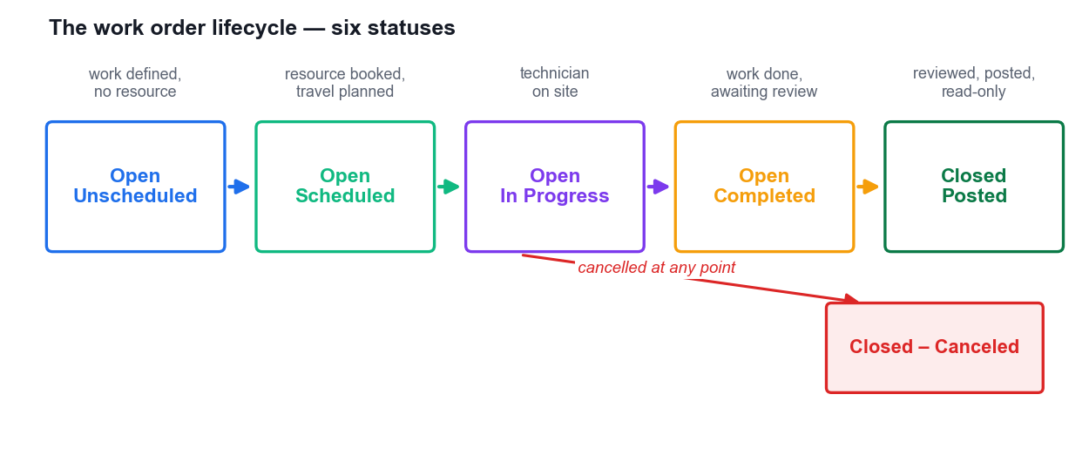
SIX STATUSES
The Work Order Lifecycle
Open – Unscheduled
The work is defined but nobody is booked. It sits in the dispatcher's queue.
Open – Scheduled
A resource is booked with a time slot and a travel plan.
Open – In Progress
The technician has arrived and started work; actual times are recorded.
Open – Completed
The work is done, awaiting review and posting.
Closed – Posted
Reviewed, products and services posted, read-only. Or Closed – Canceled.
Microsoft Dynamics 365 Fundamentals (CRM) (MB-910) · TGS-2023040481
© 2026 Tertiary Infotech Academy Pte Ltd
97

Slide 98
ANATOMY OF THE CENTRAL RECORD
What a Work Order Carries
Service account and address
Who the work is for and exactly where — geo-coded for travel calculation.
Incident type
The kind of problem, which pre-populates duration, required skills, tasks and products.
1
2
Service tasks
The checklist of what the technician must actually do, with estimated durations.
Products and services
Parts expected to be used and the labour to be billed.
3
4
Time windows
Promised From and Promised To — the appointment window given to the customer.
Priority and territory
Drives scheduling urgency and which team of resources can be considered.
5
6
Microsoft Dynamics 365 Fundamentals (CRM) (MB-910) · TGS-2023040481
© 2026 Tertiary Infotech Academy Pte Ltd
98

Slide 99
WHAT THE TECHNICIAN ACTUALLY TOUCHES
Inspections and the Mobile App
Inspections — the data
Mobile — the tool
• Inspections are digital forms
– Drag-and-drop question sets: yes/no, number, text, photo, single/multi-select
– Easier to create than the old service task model
– Faster to fill in on a phone, and works offline
– Must be PUBLISHED before use; edits create a new version
– Responses are reportable data, not a scanned paper form
• The Field Service mobile app
– Built on Power Platform — configurable without code
– The day's bookings, routes and work order details
– Customer asset history: what was done here before
– Guided inspections, photo capture, parts used, signature
– Offline capability — the basement with no signal still works
Together they raise the first-time fix rate: the technician arrives knowing the history and leaves with the evidence captured.
Microsoft Dynamics 365 Fundamentals (CRM) (MB-910) · TGS-2023040481
© 2026 Tertiary Infotech Academy Pte Ltd
99

Slide 100
TOPIC 09 · HANDS-ON LAB
LAB 9 · 55 MIN
Lab 9 — Create and Complete a Work Order with an Inspection
A Contoso customer's espresso machine has failed on site. You create the work order with its incident type, products and services, attach a digital inspection the technician must complete, then drive the work order through its full status lifecycle from Open–Unscheduled to Closed–Posted, reviewing the mobile experience the technician would actually use.
1
2
3
4
5
▶
▶
▶
▶
Create the work order and set its incident type
Add service tasks, products and services
Build and attach the digital inspection
Progress the work order through its statuses
Review the mobile technician experience
YOU'LL PRODUCE A work order with an incident type, service tasks, products and services, a published inspection attached and completed, driven through every lifecycle status to Closed–Posted.
Tools: Dynamics 365 Field Service, Dataverse, incident types, inspections, Field Service mobile app · Full step-by-step: Learner Guide, Lab 9
Microsoft Dynamics 365 Fundamentals (CRM) (MB-910) · TGS-2023040481
© 2026 Tertiary Infotech Academy Pte Ltd
100

Slide 101
10
TOPIC 10
Field Service Scheduling Capabilities and Related Apps
Resource and scheduling processes · the schedule board and schedule assistant · asset management · Connected Field Service and IoT
Microsoft Dynamics 365 Fundamentals (CRM) (MB-910) · TGS-2023040481
© 2026 Tertiary Infotech Academy Pte Ltd
101

Slide 102
WHAT A SCHEDULING SOLUTION MUST ANSWER
The Five Scheduling Questions
Is it ready to schedule?
Are the parts available, is the site accessible, has the customer confirmed?
Who is QUALIFIED?
Which resources hold the required characteristics — certifications and skills?
1
2
Who is AVAILABLE?
Whose working hours and existing bookings leave room in the promised window?
Who is NEAREST?
Travel time is unbillable cost — proximity is money.
3
4
What does it COST?
Some resources are more expensive; some jobs justify the premium.
Answer all five, fast
A dispatcher may make hundreds of these decisions a day.
5
6
Microsoft Dynamics 365 Fundamentals (CRM) (MB-910) · TGS-2023040481
© 2026 Tertiary Infotech Academy Pte Ltd
102

Slide 103
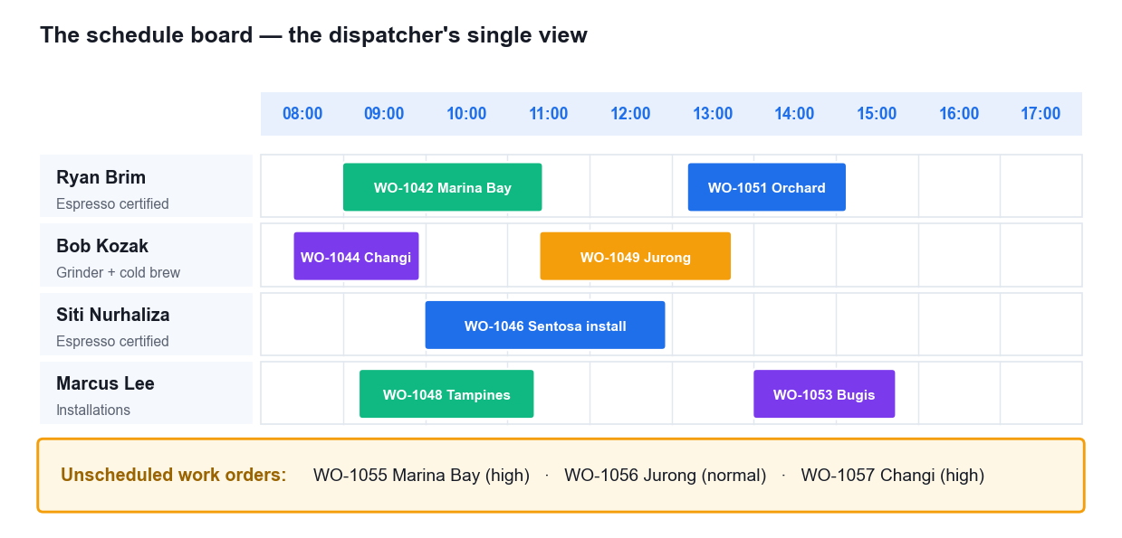
THE DISPATCHER'S SINGLE VIEW
The Schedule Board
Resources down, time across
Every technician's day laid out on one grid.
Bookings are the blocks
Drag to move, right-click to substitute or reschedule.
The requirements panel
Unscheduled work orders waiting at the bottom, ready to be assigned.
The map view
See where resources and jobs are, so travel decisions are visual.
Filters keep it manageable
By territory, skill, resource type or booking status.
Microsoft Dynamics 365 Fundamentals (CRM) (MB-910) · TGS-2023040481
© 2026 Tertiary Infotech Academy Pte Ltd
103

Slide 104
MANUAL → ASSISTED → AUTOMATED
Three Ways to Schedule
Method
How it works
Best for
Trade-off
Manual
Drag the requirement onto a resource's row on the board
Urgent jobs, known preferences, small teams
Bypasses constraint checking — you can double-book
Schedule assistant
Filters by skill, territory, availability and proximity, then ranks candidates
Most day-to-day scheduling
One booking at a time; still a human decision
Resource Scheduling Optimization
Runs on a schedule and optimises many bookings at once
Large teams, dense routes, changing conditions
Extra licence; needs well-maintained data to trust
Most organisations run all three: optimisation for the routine bulk, the assistant for exceptions, manual for emergencies.
Microsoft Dynamics 365 Fundamentals (CRM) (MB-910) · TGS-2023040481
© 2026 Tertiary Infotech Academy Pte Ltd
104

Slide 105
THE THREE MOVES AND WHEN TO USE THEM
Dispatcher Moves When Plans Change
Move
Drag the booking to a different time or day — same resource, new slot.
Substitute Resource
Find Substitution ranks other qualified resources and transfers the booking.
Rebook
Send the requirement back through the schedule assistant for a fresh slot.
1
2
3
Technician sick?
Substitute — the work still needs the same skills, just a different person.
Customer wants later?
Move — the resource is fine, only the time changes.
Emergency job?
Rebook the displaced routine work, then schedule the emergency.
4
5
6
Microsoft Dynamics 365 Fundamentals (CRM) (MB-910) · TGS-2023040481
© 2026 Tertiary Infotech Academy Pte Ltd
105

Slide 106
TRACKING THE EQUIPMENT OVER ITS LIFE
Customer Assets
See every asset per customer
All the equipment they own, in one list on the account.
Know where it is
Which site, which floor, which room — so the technician finds it.
1
2
Track work against it
Every work order ever raised on THAT specific unit, by serial number.
Build a hierarchy
A machine with its boiler, grinder and pump as child assets.
3
4
Record the specifics
Model, serial number, install date, warranty end, service history.
Inform the next visit
The technician arrives already knowing what was done last time and why.
5
6
Microsoft Dynamics 365 Fundamentals (CRM) (MB-910) · TGS-2023040481
© 2026 Tertiary Infotech Academy Pte Ltd
106

Slide 107
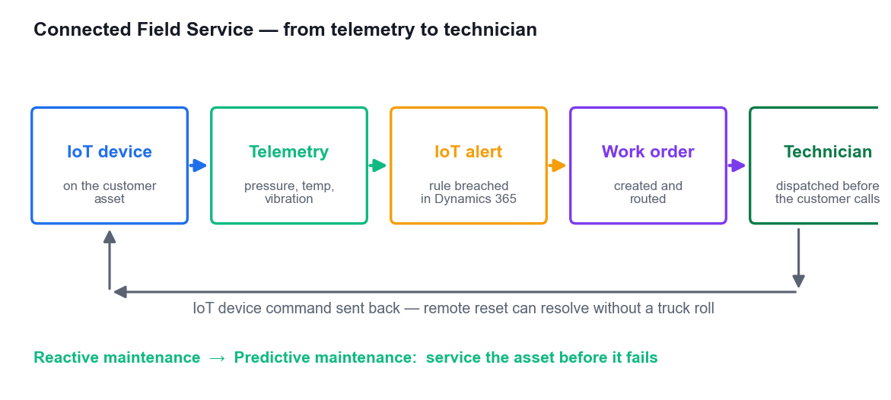
FROM REACTIVE TO PREDICTIVE
Connected Field Service
Device on the asset
An IoT device registered in Azure IoT Hub and linked to the customer asset.
Telemetry streams in
Pressure, temperature, vibration, usage — continuously.
Rules raise alerts
A breach creates an IoT Alert record in Dynamics 365.
The alert creates work
Automatically, or after a human triages it — a work order with the asset attached.
Or fix it remotely
An IoT device command can reset the equipment without sending anyone.
Microsoft Dynamics 365 Fundamentals (CRM) (MB-910) · TGS-2023040481
© 2026 Tertiary Infotech Academy Pte Ltd
107

Slide 108
THE MOVING PARTS
The Seven Connected Field Service Components
Component
What it is
Customer Asset
The specific piece of equipment the customer owns
Device Category
Groups devices of the same kind so they share configuration
IoT Device
The registered physical device that sends telemetry
IoT Alert
A notification raised when telemetry breaches a rule
IoT Device Command
An instruction sent back down to the device
Command Definition
The template describing an available command and its parameters
Property Definition
The telemetry properties a device reports and their units
The business case: reduce downtime, diagnose before the customer notices, and avoid the truck roll entirely when a remote command will do.
Microsoft Dynamics 365 Fundamentals (CRM) (MB-910) · TGS-2023040481
© 2026 Tertiary Infotech Academy Pte Ltd
108

Slide 109
TOPIC 10 · HANDS-ON LAB
LAB 10 · 55 MIN
Lab 10 — Schedule Resources, Manage Assets and Connect IoT
The work order from Lab 9 must now be scheduled, and the customer's equipment tracked over its life. You book the work with the schedule assistant, work the schedule board as a dispatcher (rebook, substitute, move), build the customer asset hierarchy with its service history, and register an IoT device so an alert can raise a work order automatically. This completes LO3, LO4 and LO5.
1
2
3
4
5
▶
▶
▶
▶
Book the work order with the schedule assistant
Work the schedule board as a dispatcher
Rebook, substitute and move bookings
Build the customer asset hierarchy and history
Register the IoT device and raise an alert
YOU'LL PRODUCE A booked work order on the schedule board, a rebooked and substituted booking, a customer asset hierarchy with service history, and an IoT device registered against an asset with an alert that creates a work order.
Tools: Dynamics 365 Field Service, schedule board, schedule assistant, Resource Scheduling Optimization, customer assets, Connected Field Service, Azure IoT · Full step-by-step: Learner Guide, Lab 10
Microsoft Dynamics 365 Fundamentals (CRM) (MB-910) · TGS-2023040481
© 2026 Tertiary Infotech Academy Pte Ltd
109

Slide 110
WRAP-UP
Course Summary & Next Steps
Microsoft Dynamics 365 Fundamentals (CRM) (MB-910) · TGS-2023040481
© 2026 Tertiary Infotech Academy Pte Ltd
110

Slide 111
LEARNING OUTCOMES DELIVERED
What You Achieved
1
Implemented CRM capabilities
Navigated the platform, explored Dataverse, and built customers, activities and reporting. (LO1)
2
Defined customer journeys
Built segments, emails, journeys, forms and events in Customer Insights – Journeys. (LO2)
3
Optimised deployment
Ran the lead-to-cash cycle, the case lifecycle and the work order lifecycle end to end. (LO3)
4
Drew actionable insights
Read pipelines, forecasts, service KPIs and sentiment to evaluate team performance. (LO4)
5
Recommended investment
Compared Sales Insights tiers and scheduling methods, and wrote the recommendation. (LO5)
Microsoft Dynamics 365 Fundamentals (CRM) (MB-910) · TGS-2023040481
© 2026 Tertiary Infotech Academy Pte Ltd
111

Slide 112
CONTINUING THE JOURNEY
Where to Go Next
Practise in a trial
A 30-day Dynamics 365 trial at trials.dynamics.com keeps every lab repeatable.
Sit the MB-910 exam
Microsoft Certified: Dynamics 365 Fundamentals (CRM) — the credential this course maps to.
1
2
Go deeper on one app
Role-based certifications exist for Sales (MB-210), Service (MB-230) and Field Service (MB-240).
Learn the platform
PL-900 Power Platform Fundamentals is the natural companion to this course.
3
4
Build something
The fastest way to consolidate: model a real process from your own organisation.
Keep the materials
Your slides, Learner Guide and lab files stay available on the LMS/TMS portal.
5
6
Microsoft Dynamics 365 Fundamentals (CRM) (MB-910) · TGS-2023040481
© 2026 Tertiary Infotech Academy Pte Ltd
112

Slide 113
EXAM READINESS · TERTIARY INFOTECH
Practice Exam
https://exams.tertiaryinfotech.com
Practise before you certify
Timed, exam-style questions across all four MB-910 skill areas.
1
Tertiary Infotech Practice Exams
Microsoft Dynamics 365 Fundamentals (CRM) MB-910
Read the explanations
Each answer explains why it is right — and why the others are not.
2
Question 7 of 50
Which app unifies data into a single customer profile?
Target your revision
Weak area? Go back to that topic's slides and lab.
A. Customer Insights – Journeys
3
B. Customer Insights – Data
Then sit the real exam
MB-910 via Pearson VUE, or the free Microsoft practice assessment.
C. Customer Voice
4
https://exams.tertiaryinfotech.com · Exam voucher: www.tertiarycourses.com.sg/microsoft-fundamentals-certification-exam-voucher.html
Microsoft Dynamics 365 Fundamentals (CRM) (MB-910) · TGS-2023040481
© 2026 Tertiary Infotech Academy Pte Ltd
113

Slide 114
CONTINUE YOUR MICROSOFT JOURNEY
Recommended Follow-On Courses
1
Microsoft Power Platform Fundamentals (PL-900)
WSQ funded · Tertiary Infotech Academy
2
Microsoft Power BI Data Analyst (PL-300)
WSQ funded · Tertiary Infotech Academy
3
Microsoft Power Apps Low-Code Application Development
WSQ funded · Tertiary Infotech Academy
4
Microsoft Power Automate Workflow Automation
WSQ funded · Tertiary Infotech Academy
5
Microsoft Azure AI Fundamentals (AI-900)
WSQ funded · Tertiary Infotech Academy
Microsoft Dynamics 365 Fundamentals (CRM) (MB-910) · TGS-2023040481
© 2026 Tertiary Infotech Academy Pte Ltd
114

Slide 115
WE'RE HERE TO HELP
Support
Email us
enquiry@tertiaryinfotech.com — during and after the class.
Call us
+65 6100 0613
1
2
Course catalogue
www.tertiarycourses.com.sg
Your course material
lms-tms.tertiaryinfotech.com — slides, guide, labs and assessment.
3
4
Microsoft Dynamics 365 Fundamentals (CRM) (MB-910) · TGS-2023040481
© 2026 Tertiary Infotech Academy Pte Ltd
115

Slide 116
FINAL ASSESSMENT
Assessment
Written Assessment (WA)
Short-Answer Questions — 1 hour. Tests the knowledge behind the four MB-910 skill areas.
Practical Performance (PP)
Hands-on Dynamics 365 tasks — 1 hour. Drawn from the ten labs you completed.
1
2
Open book
Course slides, Learner Guide and approved materials only.
Attendance first
Take the Assessment digital attendance before you start.
3
4
Submit on the LMS
Upload your completed answers at lms-tms.tertiaryinfotech.com.
Competent in BOTH
Both instruments must be passed to be awarded the certificate.
5
6
Microsoft Dynamics 365 Fundamentals (CRM) (MB-910) · TGS-2023040481
© 2026 Tertiary Infotech Academy Pte Ltd
116

Slide 117
ON ASSESSMENT DAY
Assessment Flow
Survey → attendance → Written Assessment → Practical Performance → sign the Assessment Summary Record.
Microsoft Dynamics 365 Fundamentals (CRM) (MB-910) · TGS-2023040481
© 2026 Tertiary Infotech Academy Pte Ltd
117

Slide 118
MANDATORY · SSG / WSQ
Digital Attendance & TRAQOM Survey
Three attendance takes
AM, PM and Assessment — every day of a WSQ-funded course.
1
The trainer shows the QR
Generated live from the SSG portal — it changes each session.
2
Scan and submit
Open your phone camera, scan, and submit your attendance.
3
75% minimum
Below 75% attendance you lose funding eligibility and cannot be assessed.
4
Scan with your phone camera
TRAQOM survey
Complete the mandatory course survey on the LMS before you leave.
5
Microsoft Dynamics 365 Fundamentals (CRM) (MB-910) · TGS-2023040481
© 2026 Tertiary Infotech Academy Pte Ltd
118

Slide 119
SEE YOU IN THE NEXT COURSE
Thank You!
You can now navigate Dynamics 365, describe every customer engagement app, and explain how marketing, sales, service and field operations run on one platform.
Microsoft Dynamics 365 Fundamentals (CRM) (MB-910) · TGS-2023040481
© 2026 Tertiary Infotech Academy Pte Ltd
119

